Slide 1
Fiery FS300 Pro – Neuerungen
Name des Vortragenden
Titel
Notes:
This presentation will give you a closer look into what’s new in this new platform and offers the marketing positioning and overall message for the launch of Fiery FS300 Pro.

Slide 2
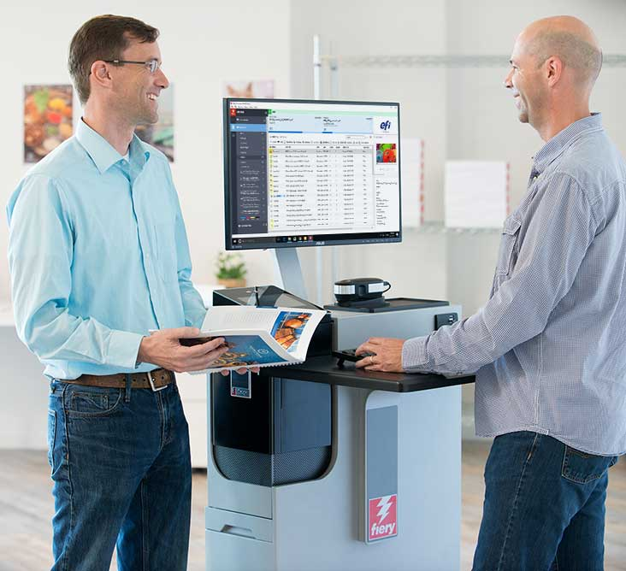
Was ist die Fiery FS300 Pro Plattform?
„Eine Plattform für das nächste Jahrzehnt“
Anwender an erster Stelle
Innovationen bei nahezu jeder Anwenderinteraktion mit Fiery®
Neue Funktionen in den Schlüsselbereichen, die Anwender interessieren: Farbe, Produktivität, Benutzerfreundlichkeit und Integration
Steuerung von Fiery Driven™ Druckmaschinen
Bogendruck, schnelle Endloszufuhr, B1-Faltkarton und Wellpappe
Notes:
Let’s first answer “What is the Fiery FS300 Pro”? And what does FS300 Pro mean for users?
First of all, Fiery FS300 Pro is not just system software, it is a platform. It’s a platform that converges all aspects of a digital front end, or DFE, solution. Fiery DFEs include hardware, software, workflow solutions, and more.
FS300 Pro platform defines and sets the direction for Fiery servers in the next decade by:
Focusing on users with a redesign and innovation in almost every single touch point the user has with Fiery. This includes everything from exterior design that incorporates a Fiery QuickTouch display to interact with the Fiery server, to the furniture stand, and all aspects of user interface in Command WorkStation.
And, of course, FS300 Pro adds new features in the key areas users care about: colour, productivity, usability, and integration.
In addition to that, FS300 Pro drives multiple print technologies, not only cutsheet toner presses. With ever-increasing demands for faster thoughput in production printing, Fiery is now driving very high-speed presses such as the Xerox Trivor 2400, Landa’s Nanographic presses, our own Nozomi for corrugated, and many other engines.

Slide 3
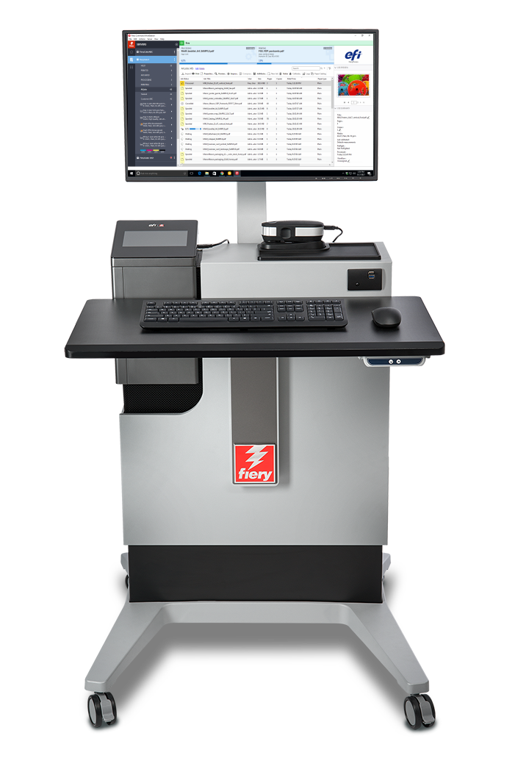
Innovationen der neuen Plattform
Fiery FS300 Pro Systemsoftware
Fiery Command WorkStation®
Fiery NX und XB Plattformen
Fiery Workflow für die Druckvorbereitung
Notes:
As you can see in this slide, all the latest innovations ship with this new Fiery DFE platform.
A new user interface, with Command WorkStation 6
A new industrial design and hardware specs for Fiery NX and Fiery XB servers
A new codebase with FS300 Pro system software
And major enhancements to Fiery makeready solutions

Slide 4
Neue Fiery FS300 Pro Funktionen
Unterstützung von 7 Farben
Priorisierung von Spot-Farbgruppen
Eingabeprofil für Graustufen
Fiery ImageViewer
Objektinspektor
Gesamtflächendeckung
Neue Hardware
APPE 4*
Verbesserte HyperRIP Technologie
Schnelle Nachdrucke
Fiery Impose:
Verbesserte autom. Sammelformerstellung
Autom. Drehen von Seiten
Vorgaben für Marken
Fiery Command WorkStation 6
Vorschau für alle Aufträge
Autom. Entfernen von Rasterdaten
Fiery NX Design
Fiery QuickTouch
Fiery NX Station
Fiery JobMaster:
Bildobjekte in Stempelung
Importieren gescannter Seiten
Seitenversatz
Allgemein verbesserte Druckvorbereitung
Windows 10
Verbesserte Sicherheit
Autom. Systemsicherungen
Fiery Updates von Command WorkStation
802.1x EAP-TLS
Autom. Proxy-Konfiguration
Optimierte Integrationsoptionen
* Kontinuierliche Aktualisierung von APPE durch Servicereleases
Notes:
Another way to see what’s new in FS300 Pro across print technologies, is to look at areas users care about the most.
As you can see, all areas are represented with new features to reinforce Fiery leadership in the print industry.
Let’s examine these new features in the following slides.

Slide 5
Fiery Command WorkStation 6
Intuitive Benutzeroberfläche zur Druckauftragsverwaltung für Fiery Server
Notes:
Let’s start first with Command WorkStation 6 — the new user interface for print job management for Fiery DFEs.

Slide 6
Fiery Command WorkStation 6
Effizientere Auftragsverwaltung, höhere Produktionsleistung
Intuitiver Bedienkomfort
Hohe Effizienz und Produktivität
Neue Werkzeuge für Produktionsleiter
Nahtloses schnelles Upgrade
Zukunftssichere Lösung
Vollständige Präsentation
Notes:
Version 6 offers better usability and higher efficiency. And all you have to do to get these benefits is to download it for free from efi.com/cws.
In addition to operator benefits, there are also new tools for production managers.
Version 6 works with Fiery servers running Fiery System 10 and above, and also provides future connectivity to Fiery servers driving wide- and superwide-format printers.

Slide 7
Neue Funktionen in Version 6
Einfacher Übergang von Version 5
Nahtloses schnelles Upgrade
Einführung und erste Schritte
Intuitiver Bedienkomfort
Moderne, übersichtlich strukturierte Oberfläche
Hohe Effizienz und Produktivität
Auftragsvorschau für alle Aufträge*
Automatisches Entfernen der Rasterdaten*
Schnelle Nachdrucke*
Funktionen für die Auftragssuche
Einfache Suche
Erweiterte Suche
Eigene Ansichten und Filter
Farbeinstellungen in Auftragseigenschaften
Festlegen von Standardwerten
Standardeinstellungen für Farbmanagement
Inline-Bearbeitung
Neue Werkzeuge für Produktionsleiter
Startseite
Serverstatus
Übersicht kritischer Produktionsdaten
Fiery Updates
Festlegen von Standardwerten
* Neue Funktionen – nur für FS300 Pro Server
Notes:
The list of new features has some that were specifically designed to work with FS300 Pro servers or later.
Job preview for all jobs works only on external Fiery servers running Fiery FS300 Pro
Automatically remove rasters and fast reprint is supported by both, external and embedded servers running Fiery FS300 Pro/FS300.

Slide 8
Neue Funktionen in Druckvorbereitungslösungen
Fiery Impose Fiery Compose Fiery JobMaster | Höhere Benutzerfreundlichkeit Einfaches Festlegen von Voreinstellungen, Beibehalten von Fenster-/Bereichsgrößen, Anzeigen der Medienfarbe, optimiertes Einfügen von Seiten, beschleunigtes Speichern von Aufträgen und Festlegen der Bogengröße Acrobat DC Professional und PitStop Edit 13
Fiery Impose | Automatisiertes Erstellen von Sammelformen auf Basis der Mediengröße Autom. Drehen von Seiten Vorgaben für Marken Variabler Datendruck: Gemischte Medien für Titel-/Abschlussblätter Workflow-Automatisierung für japanische Schnittmarken Kostenlose 30-Tage-Testversion
Fiery JobMaster | Bildobjekte in Stempelung Importieren gescannter Seiten Seitenversatz Kostenlose 30-Tage-Testversion
* Neue Funktion – nur für FS300 Pro Server
Vollständige Präsentation
Notes:
In the list of makeready new features, there is also one feature that is specific to FS300/FS300 Pro servers (embedded or external) — the ability to save Impose templates containing Japanese crop marks. This allows users to automate job layout preparation using this type of crop mark.

Slide 9
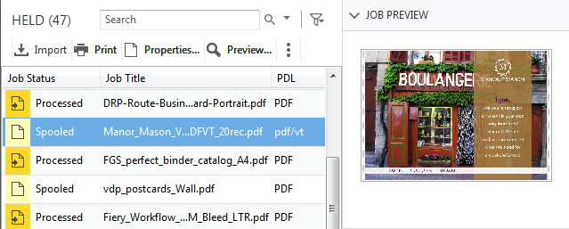
Auftragsvorschau für alle Aufträge
Schnellere Auftragsidentifizierung
Keine Leistungseinbußen
Vorschau nur für erste Seite
Unterstützte Dateiformate:
PS, PDF, PDF/VT, TIF, EPS
Nur für externe Fiery Server verfügbar
Notes:
Users with external Fiery servers running FS300 Pro and Windows 10 can now preview all jobs. This helps operators identify and find jobs faster.
Previewing jobs doesn’t impact the Fiery server performance, so the feature is always on. The preview lets operators see the first page of the job.
While the feature doesn’t work with PPML files, it does work with PostScript, PDF, PDF/VT, TIF, and EPS files.

Slide 10
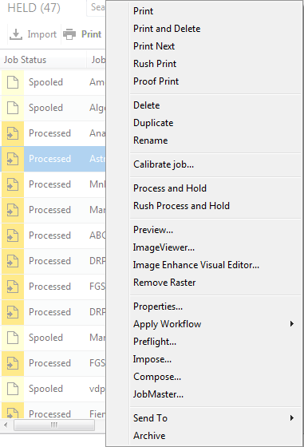
Autom. Entfernen von Rasterdaten
Zugriff auf Einstellungen zur Druckvorbereitung mit einem Klick
Identische Auftragsaktionen für verarbeitete Aufträge wie für gespoolte Aufträge
Notes:
The next feature is called “automatically remove rasters.”
With this feature, users who want to resume the job layout and makeready settings after processing a job, will no longer need to select “Remove Raster” before accessing Impose, Compose, or JobMaster. The Fiery server will “Remove Raster” automatically if any of those makeready options are selected from the Actions menu.
This shortens access to makeready settings from three clicks to one, and offers a more intuitive experience since users will see job actions for processed jobs that are consistent with those for spooled jobs.

Slide 11
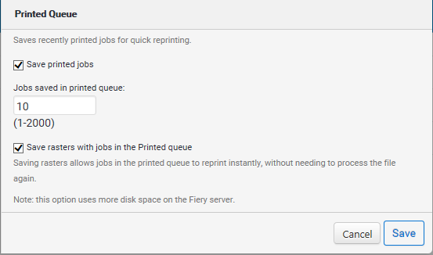
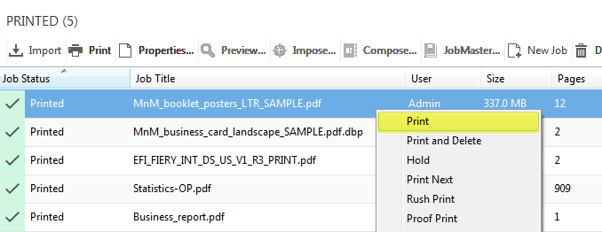
Schnelle Nachdrucke
Erneutes Drucken von Aufträgen ohne erneuten RIP-Vorgang
Neue Option in Configure zum Speichern von Rasterdateien mit Aufträgen in der Warteschlange GEDRUCKT
Aktivierte Configure Option „Rasterdaten zusammen mit Aufträgen in Warteschlange 'Gedruckt' speichern“
Notes:
Fast Reprint can save a lot of time.
Using this feature, administrators can keep the raster files for jobs in the PRINTED queue. When the print service provider needs to reprint those jobs, the files start printing the instant jobs are sent to print, without re-RIPping.
This feature is on by default and can be disabled from the Configure menu, as the screenshot on the right shows.
This is a great feature when users need to print one copy of a job as a proof, and then print it again for production. All they have to do is just change the copy count.

Slide 12
Fiery NX und XB Plattformen

Slide 13
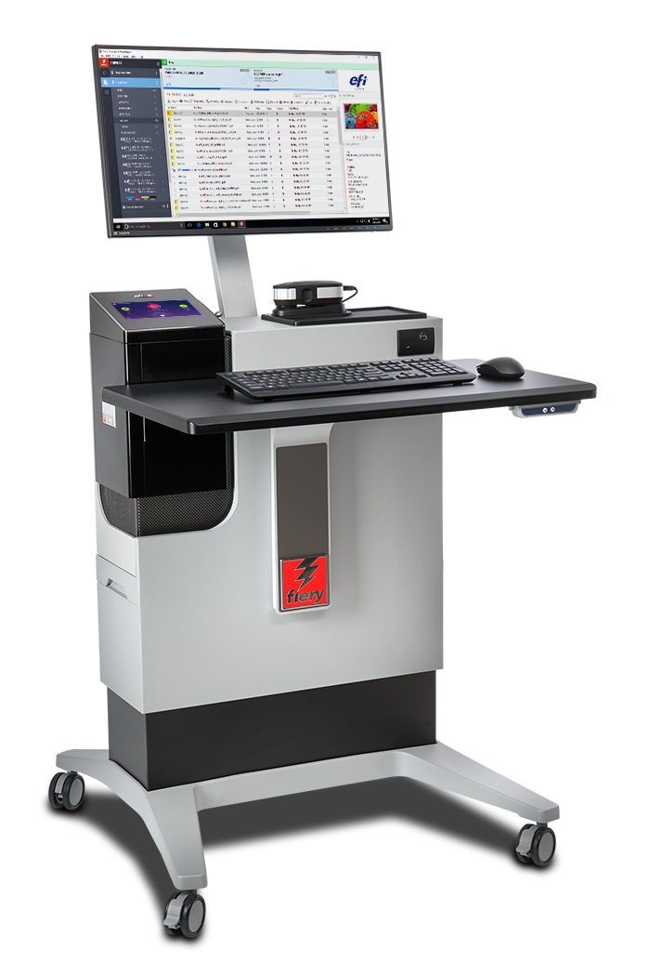
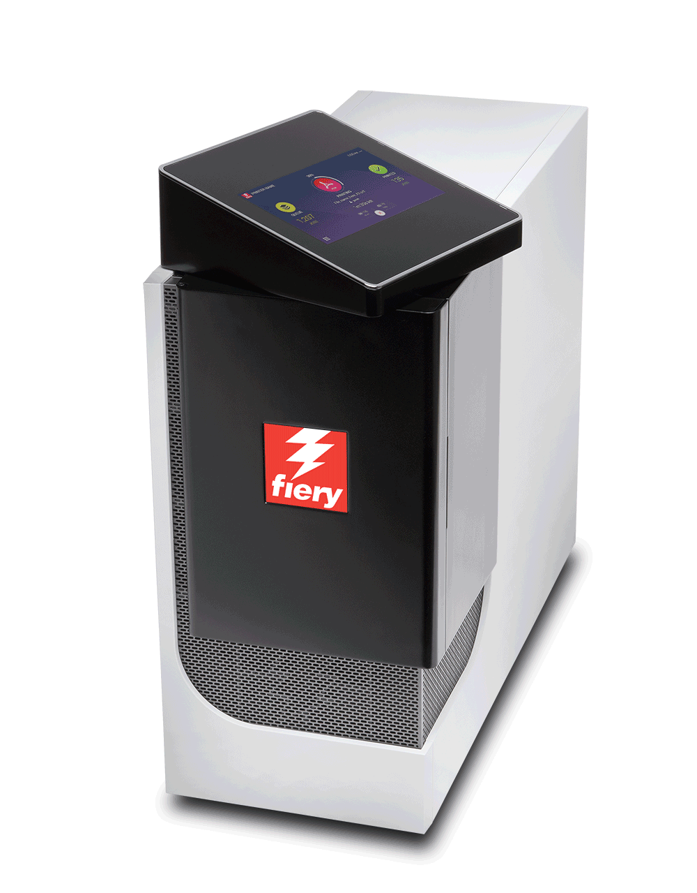
NEU – Fiery NX Premium und NX Pro
NX Server in neuem Industriedesign
Neues Touchscreen-Display mit Fiery QuickTouch Software
Effizienter Betrieb mit neuer NX Station
Webseite „Fiery Produktionslösungen“
Drehbares Touchscreen-Bedienfeld
Notes:
FS300 Pro servers feature the cutting-edge and innovative Fiery NX industrial design that was precisely crafted with the Fiery operator in mind.
The Fiery NX Premium is the high-end Fiery DFE that replaces the Fiery QX100 servers. The Fiery NX Pro is the server that replaces the Fiery Pro 80 hardware platforms.
The new server design includes the Fiery QuickTouch interface that helps users speed up job and device management. The touchscreen display rotates and provides intuitive system installation, backup, and diagnosis; plus easy access to and faster views of job status information. It also includes 3 USB ports, conveniently located on the side of the display
Either the Fiery NX server (Premium or Pro) can be placed inside the new Fiery NX Station to provide a centralised work station that adapts to different print production environments. The work stations come in two versions: The NX Station GL is the basic configuration, and the NX Station LS adds an adjustable-height workspace, a larger monitor, a proximity sensor that wakes up the Fiery server as soon as it identifies someone approaching, and tidy power cable storage.

Slide 14
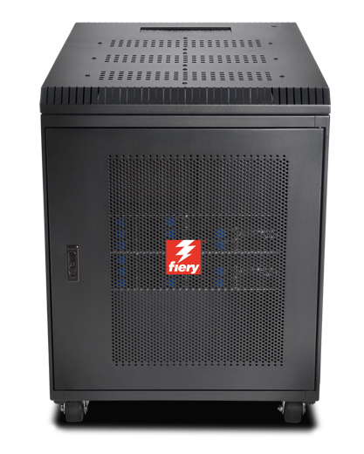
Fiery XB
Ausgelegt für eine Vielzahl von Märkten
Verpackungen Faltkarton, Wellpappe und flexible Verpackungen
Akzidenzdruck
Transaktion/IPDS, Direktmailings
Hohe Leistung, Blade-Architektur
Bis zu 1,8 m x 3 m große Bogen oder 1 m breite Bahnen
Bis zu 15.000 SPH (B1, 1200 x 1200 dpi)
Bis zu 200 m/min Rollendruck (1 m, 1200 x 1200 dpi)
Notes:
The Fiery XB hardware platform is designed for a wide variety of high-production markets such as packaging, commercial print, and transactional.
Its high-performance, bladed architecture fulfills demands for high throughput and a wide range of paper widths.

Slide 15
Fiery FS300 Pro Systemsoftware
Wettbewerbsfähigkeit für Druckereien durch unvergleichliche Produktivität, Farbqualität und Integration
Notes:
This section covers the new features in the Fiery system software — Fiery FS300 Pro

Slide 16
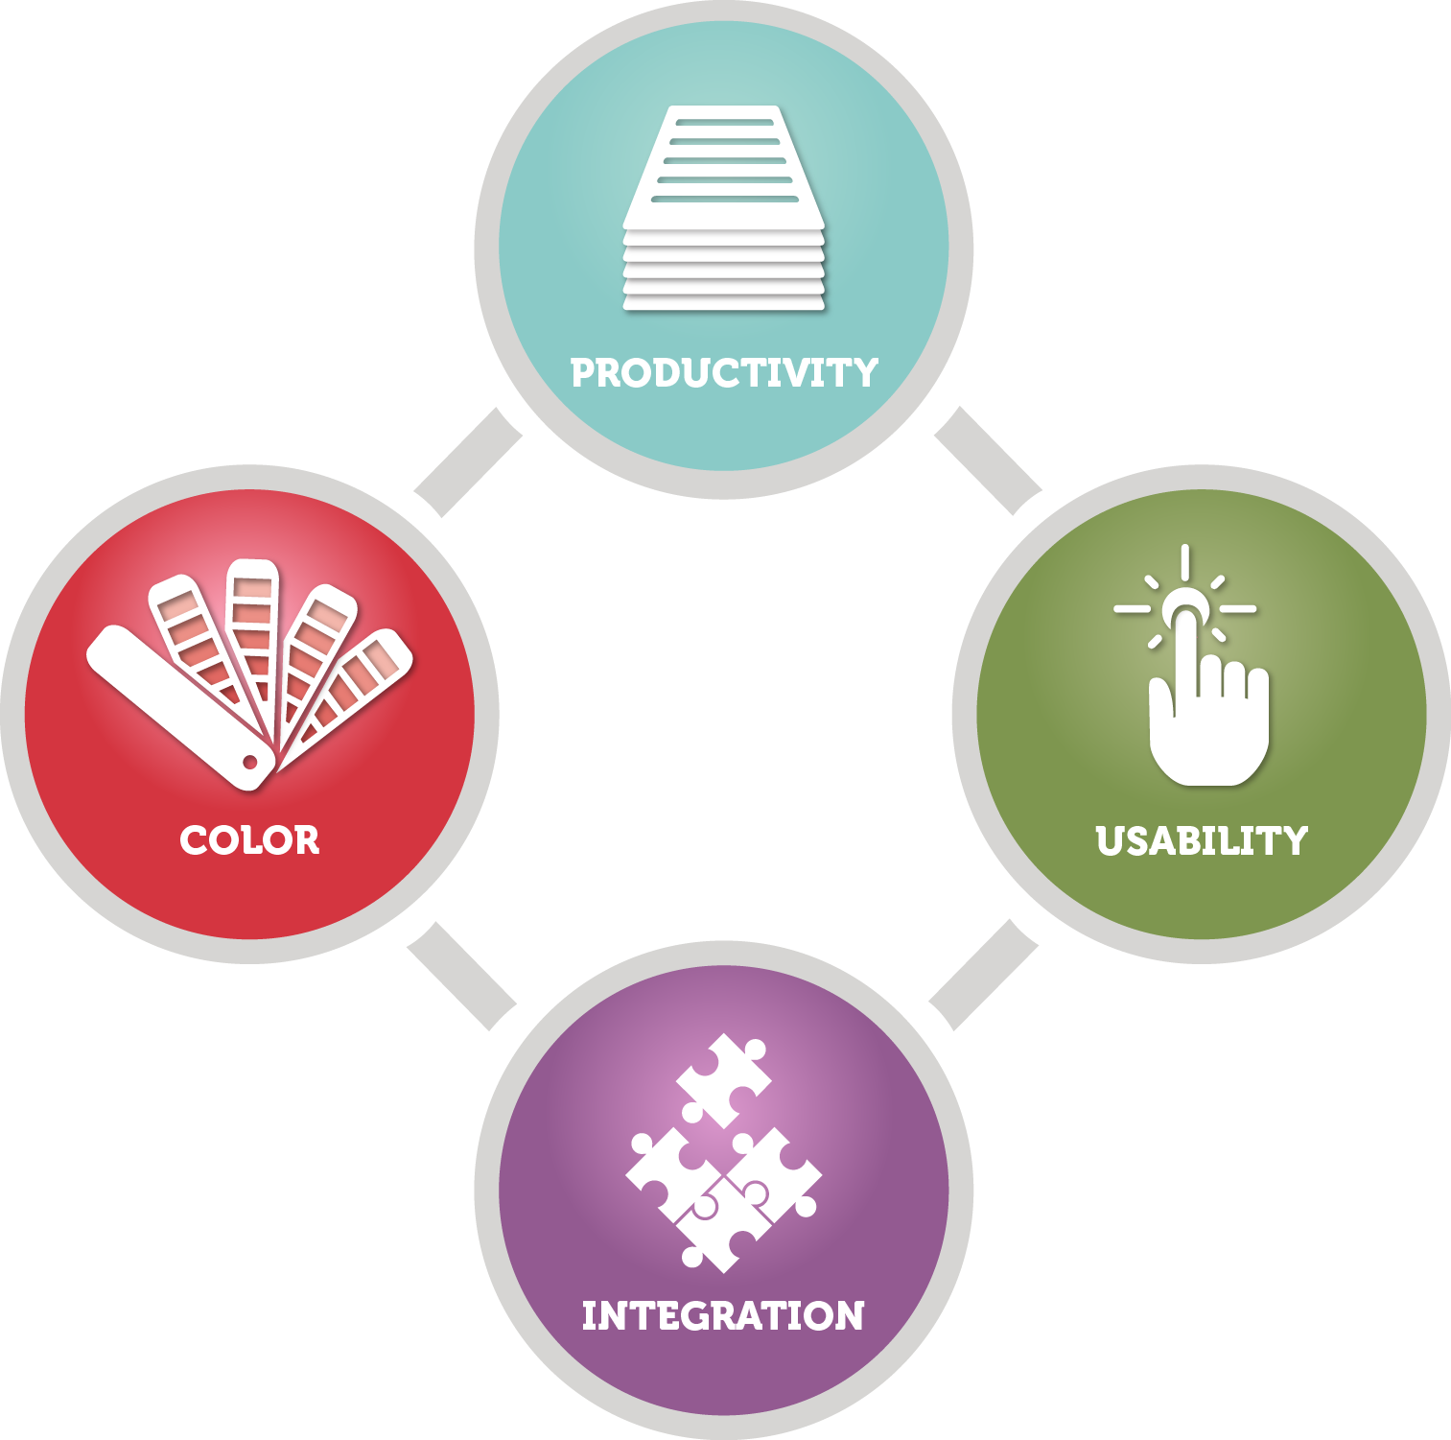
FS300 Pro Schwerpunkte
Kontrolle der Ausgabequalität
Leistung
Sicherheit
Wartungsfreundlichkeit
Integration
Notes:
The new features target the areas users care most about:
Output quality control
Performance
Security
Serviceability
Integration

Slide 17
Kontrolle der Ausgabequalität
Fiery Spot-On™
Priorisierung von Spot-Farbgruppen
Fiery ImageViewer
Objektinspektor
Gesamtflächendeckung
Notes:
There are several new features that offer new tools to enhance output quality control, and are great additions for professional prepress environments:
The Fiery Spot-On feature adds spot colour group priority
Fiery ImageViewer, part of Fiery Graphic Arts, Premium Edition and Fiery Productivity Package, adds object inspector and total area coverage features

Slide 18
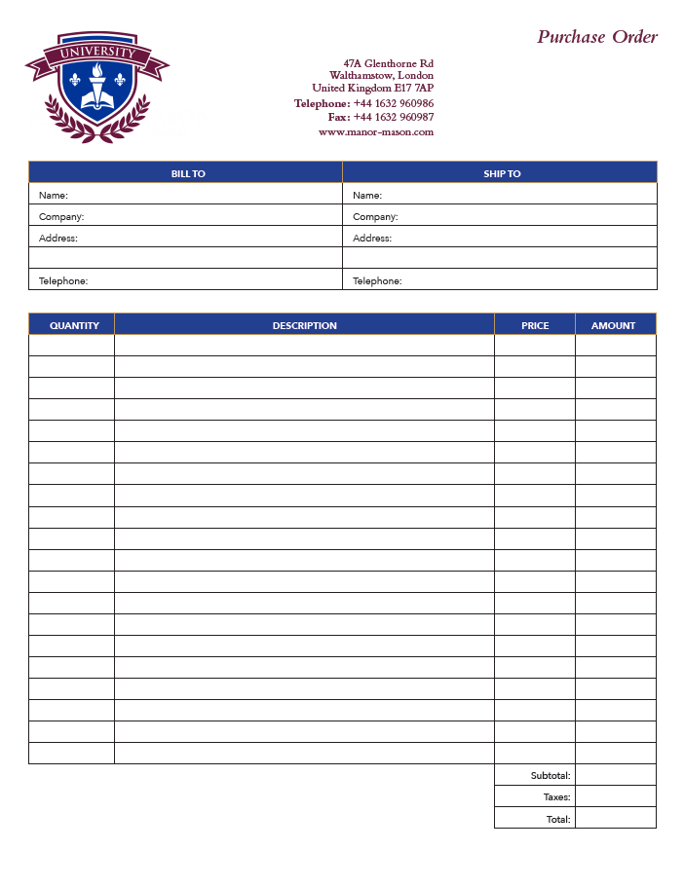
Priorisierung von Spot-Farbgruppen
Einfache Einstellung eigener Farben
Definieren der Reihenfolge der Farbbibliotheken nach Auftrag
Zeiteinsparung durch Neuanordnung der Farbgruppen im Gerätecenter
Voraussetzung: Fiery Spot-On
Notes:
Spot colour group priority is a feature that enables users to easily ensure that custom spot colour representation is honored to satisfy print buyer’s expectations.
This is a very useful feature for print environments where Fiery users edit the appearance of specific spot colours to match the expectations of print buyers. These spot colour edits are saved as new groups of colours using the Spot-On interface in Device Center.
But sometimes different print buyers want different edits to the same spot colours, or one buyer may request an adjustment — but other print buyers like the default colour mapping of the spot colour.
The spot colour group priority feature allows the Fiery user to set which of the colour libraries in Spot-On takes priority for a given job from the Color tab in Job Properties or Fiery driver. This means that if the requested spot colour adjustment for one customer is created in a custom spot colour library, the library can be given priority when printing that customer's jobs without forcing the spot colour edit for all future print jobs.
This feature can save a lot of time for users who no longer need to constantly check on the order of the colour libraries or groups in Spot-On.

Slide 19
Objektinspektor
Zeigt Objekttyp für Raster-Pixel an
Text, Grafik, Bild, weiche Schatten und Kanten
Hilft bei der Identifizierung von Problemen mit objektbasierten Einstellungen:
Nur Schwarz für Grautöne
Kantenkontrastierung
Beispiel: Dynamic HD Text and Graphics
Objektbasierte Rasterdaten
Beschleunigt die Problemlösung
Voraussetzung: Fiery Graphic Arts Package, Premium Edition oder Fiery Productivity Package
Notes:
Object Inspector, part of Fiery ImageViewer 3.0, helps identify imaging problems related to specific object types. The tool identifies what type of page object was in the original page description file before it was RIPped. It can identify object types including image, graphic, smooth shade, text, and edge.
The feature allows the user to troubleshoot image quality issues related to page object type more efficiently. Some examples include the ability to:
Identify a page object that may fail to use black only because gray settings in Job Properties are not set to use black only for that object type.
Identify cases where a colour mismatch within a page is related to how each object type is processed, such as halftone screen. These colour mismatches are hard to identify since the colour looks identical in the raster, but they print with a mismatch when they are screened on the print engine.
Determine where pixels are being tagged for edge enhancement by features such as Fiery Dynamic HD Text and Graphics or engine-specific edge-enhancement technologies.

Slide 20
Gesamtflächendeckung
Zeigt die Summe der Trennwerte an
Hilft, die Bereiche mit erreichter Gesamtflächendeckung zu ermitteln
Kann bei Imaging-Fehlern wie fehlenden Schattendetails verwendet werden
Voraussetzung: Fiery Graphic Arts Package, Premium Edition oder Fiery Productivity Package
Notes:
Total Area Coverage, also part of Fiery ImageViewer 3.0, reports the sum of colour separation values for a pixel. This can help users troubleshoot image quality issues related to toner or ink coverage, and determine whether the toner or ink limit has been reached.

Slide 21
Eingabeprofil für Graustufen
Erreicht das erwartete Druckaussehen bei Graustufenbildern, Vektoren oder grafischen Objekten
Festlegen der Farbwiedergabe-Steuerelemente wie bei RGB und CMYK
Graustufeneinstellungen auf der Registerkarte „Farbe“ in Auftragseigenschaften und Treiber
Notes:
Previous Fiery servers render grayscale objects using the CMYK source profile, which can result in an unexpected and often incorrect appearance.
This feature provides users with specific control over the colour management of grayscale page objects by adding grayscale settings in the Color tab in Job Properties and the driver.
When grayscale page objects are created in a design application such as Adobe Photoshop, a grayscale ICC profile is used to define their intended appearance. This feature lets the user set the same profile to be used on the Fiery server so that the expected appearance can be maintained when printing.

Slide 22
Optimierte Leistung
HyperRIP Optimierungen
Schnelle Nachdrucke
Hardware der nächsten Generation
NX Pro und Premium Server
XB Server
HyperRIP Video ansehen
Auftragsverarbeitung um 55 % schneller
Notes:
Fiery FS300 Pro servers process jobs faster with innovative technology:
Fiery NX Premium servers include Fiery HyperRIP, which can process more file formats in this mode
All Fiery FS300 Pro servers include fast reprint from Command WorkStation 6: This features enables jobs in the PRINTED queue to start printing the instant they are sent to print again
Fiery FS300 Pro servers ship with new hardware platforms which deliver faster processing performance

Slide 23
Im Modus „Einzelauftrag“ unterstützte Dateiformate
Dateityp | Normal | Duplex | XObjects/ Formularcache | Gemisch-te Medien | Control Bar | Druckbereich Seite/Datensatz | Ausschießen | Post-flight | WS „Direkt“
CPSI-Workflow
PDF | Ja | Ja | Ja | Ja | Ja | Ja | Nein | Nein | Ja
PS | Ja | Ja | Ja | Ja | Ja | Ja | Nein | Nein | Nein
Quick Doc Merge | Ja | Ja | Ja | Ja | Ja | Ja | Nein | Nein | Nein
PDF/VT | Ja | Ja | Ja | Ja | Ja | Ja | Nein | Nein | Ja
PPML | Ja | Ja | Ja | Ja | Ja | Ja | Nein | Nein | Nein
VPS | Ja | Ja | Ja | Ja | Ja | Ja | Nein | Nein | Nein
VIPP | Ja | Ja | Ja | Ja | Ja | Ja | Nein | Nein | Nein
FreeForm Master | Nein | Nein | Nein | Nein | Nein | Nein | Nein | Nein | Nein
FreeForm Variable | Ja | Ja | Ja | Ja | Ja | Ja
TIF | Nein | Nein | Nein | Nein | Nein | Nein | Nein | Nein | Nein
EPS | Nein | Nein | Nein | Nein | Nein | Nein | Nein | Nein | Nein
APPE-Workflow
PDF | Ja | Ja | Ja | Ja | Ja | Ja | Nein | Nein | Ja
PDF/VT | Ja | Ja | Ja | Ja | Ja | Ja | Nein | Nein | Ja
PCL-Workflow
PCL | Nein | Nein | Nein | Nein | Nein | Nein | Nein | Nein | Nein
NEIN
FS200 Pro Tabelle
FS300 Pro Tabelle
Notes:
This slide shows the file formats not supported by HyperRIP before FS300 Pro in single-job mode.

Slide 24
Im Modus „Einzelauftrag“ unterstützte Dateiformate
Dateityp | Normal | Duplex | XObjects/ Formularcache | Gemisch-te Medien | Control Bar | Druckbereich Seite/Datensatz | Ausschießen | Post-flight | WS „Direkt“
CPSI-Workflow
PDF | Ja | Ja | Ja | Ja | Ja | Ja | Nein | Nein | Ja
PS | Ja | Ja | Ja | Ja | Ja | Ja | Nein | Nein | Nein
Quick Doc Merge | Ja | Ja | Ja | Ja | Ja | Ja | Nein | Nein | Nein
PDF/VT | Ja | Ja | Ja | Ja | Ja | Ja | Nein | Nein | Ja
PPML | Ja | Ja | Ja | Ja | Ja | Ja | Nein | Nein | Nein
VPS | Ja | Ja | Ja | Ja | Ja | Ja | Nein | Nein | Nein
VIPP | Ja | Ja | Ja | Ja | Ja | Ja | Nein | Nein | Nein
FreeForm Master | Nein | Nein | Nein | Nein | Nein | Nein | Nein | Nein | Nein
FreeForm Variable | Ja | Ja | Ja | Ja | Ja | Ja
TIF | Nein | Nein | Nein | Nein | Nein | Nein | Nein | Nein | Nein
EPS | Nein | Nein | Nein | Nein | Nein | Nein | Nein | Nein | Nein
APPE-Workflow
PDF | Ja | Ja | Ja | Ja | Ja | Ja | Nein | Nein | Ja
PDF/VT | Ja | Ja | Ja | Ja | Ja | Ja | Nein | Nein | Ja
PCL-Workflow
PCL | Nein | Nein | Nein | Nein | Nein | Nein | Nein | Nein | Nein
FS300 Pro Tabelle
Notes:
As you can see, FS300 Pro supports many more formats in single-job mode.

Slide 25
Verbesserte Sicherheit
Windows 10 IoT Enterprise
Schutz vor schädlichen Anwendungen mit Windows Defender SmartScreen
Schutz vor Man-in-the-Middle-Angriffen mit SMB-Absicherung und Anheften von Enterprise-Zertifikaten
Malware- und Virenschutz mit Windows Defender und Windows Data Execution Prevention
Notes:
Fiery external servers ship with the Microsoft Windows 10 IoT Enterprise 2016 LTSB edition (Windows 10) operating system, which contains the latest security protections. These key features address security protections. See the Fiery FS300 Pro Security white paper for more information.
Enable Windows Defender SmartScreen feature to prevent malicious applications from being downloaded. This additional security feature may affect Fiery server performance and is not turned on by default.
Windows 10 comes with SMB hardening for SYSVOL and NETLOGON shares, which helps mitigate man-in-the-middle attacks for Fiery servers joined to a domain.
Windows Defender Antivirus helps keep devices free of viruses and other malware. Fiery server is configured with the feature turned on to scan c:\, but not e:\ to minimise performance impact. Administrators can configure Windows Defender to scan e:\ if desired.
Windows Data Execution Prevention (DEP) can be enabled for Windows programs and services to help prevent malware from using the memory manipulation technique.
Windows 10 has better memory protections for heap and kernel pools to help prevent exploitation of memory.
Enterprise certificate pinning helps prevent man-in-the-middle attacks. This is an enterprise feature. A Fiery server has to join a domain to enable the feature.

Slide 26
Einfachere Wartung
Minimierung von Produktionsunterbrechungen
Fiery Updates
Einfaches schnelles Aktualisieren der Fiery Server
Autom. Systemsicherungen
Schnelle Wiederherstellung
Notes:
Serviceability improvements in Fiery FS300 Pro offer administrators, analysts, and technicians better ways to ensure that Fiery servers are always up to date, minimise downtime, and provide fast recovery of Fiery servers.
Fiery Updates is a new feature introduced with Command WorkStation 6. Because timely software updates are critical for optimal operation of Fiery servers, Command WorkStation offers administrators an easy way to get notifications, downloads, and installation of approved and released Fiery system updates.
Administrators access Fiery Updates through the Device Center and can perform updates, even from remote client computers. This way, they can still update even Fiery servers that may not be connected to the internet. At the Fiery Updates screen, administrators can also see all the patches and service packs available and waiting to be installed for external or embedded servers.
Fiery Updates ensures the right sequence of patch updates to guarantee effective installation and avoid incompatibilities.

Slide 27
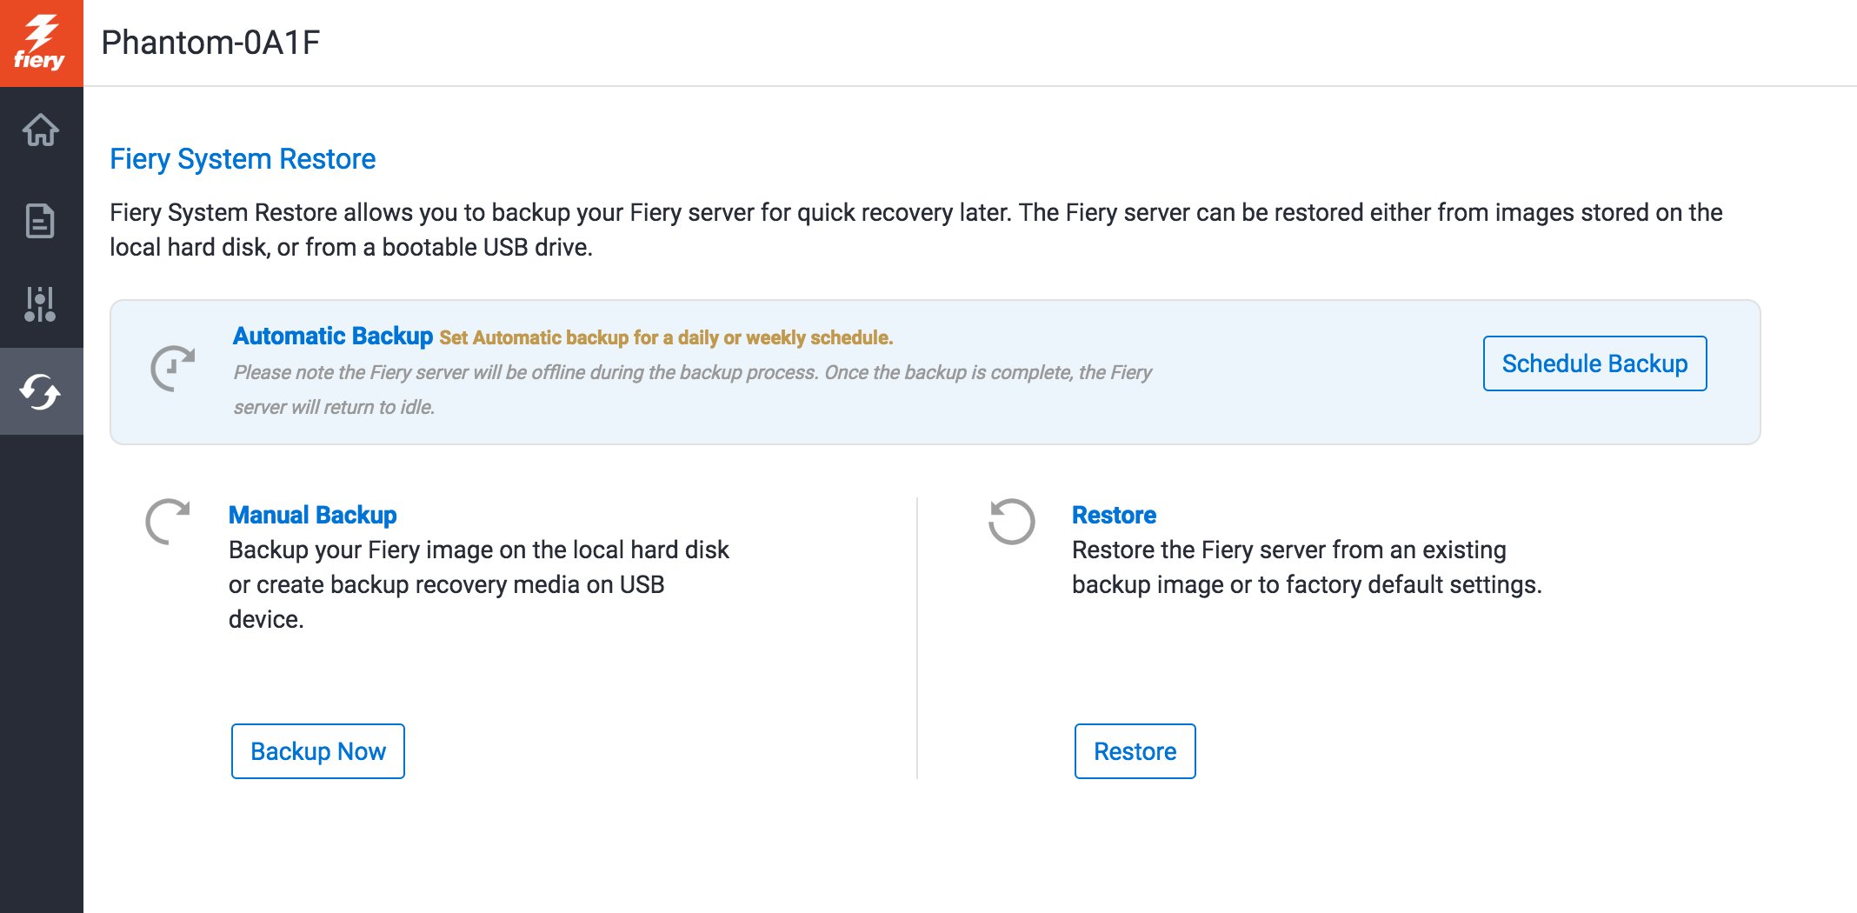
Autom. Systemsicherungen
Einrichten eines Sicherungszeitplans über Fiery QuickTouch und WebTools
Wiederherstellen des Fiery Servers in weniger als einer Stunde
In 1/8 der zum Laden von einem DVD-Kit benötigten Zeit
Kein DVD-Kit erforderlich
Notes:
Fiery administrators now have an easy way to schedule automatic Fiery system backups to guarantee fast recovery — and without the need to restore from a DVD media kit.
They can manage backups using Fiery WebTools or the Fiery QuickTouch interface. With these tools, it can take less than an hour to restore from a backup — 1/8th of the time it takes to restore from a DVD kit.

Slide 28
Optimierte Integrationsoptionen
Einfache Integration neuer APIs und benutzerfreundlicher Funktionen in eigene Anwendungen dank Fiery API v4
Neue JDF-fähige Fiery Version mit Fiery JDF v1.5
EFI AutoCount
EFI Quick Print Suite
Kodak Prinergy 8.1
Notes:
Fiery API and Fiery JDF are always improving to bring usability enhancements and tighter integration with EFI web-to-print and MIS systems plus third-party prepress workflow solutions.

Slide 29
Der Mehrwert von Fiery FS300 Pro
Führende Innovationen in für Kunden wichtigen Bereichen
Steuerung der branchenweit modernsten digitalen Druckmaschinen
Notes:
Fiery servers bring innovation to areas important to customers and continue the evolution of printing by driving the most advanced digital presses.

Slide 30
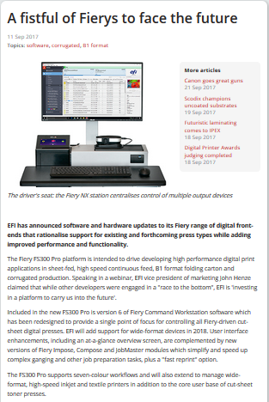
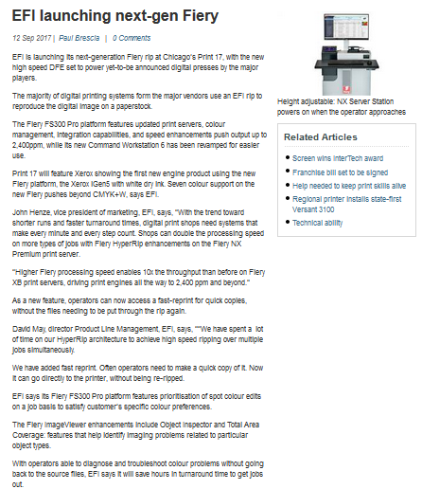
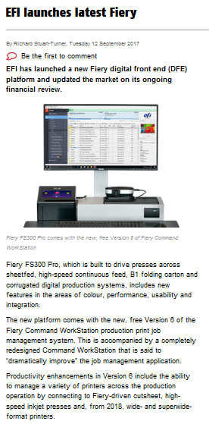
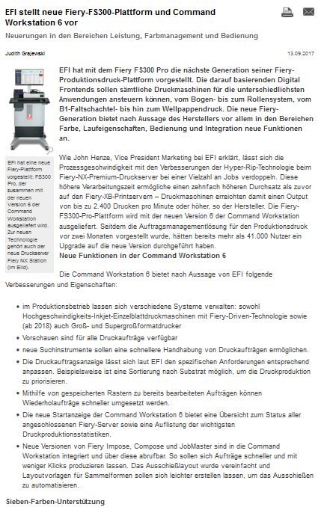
Veröffentlichungen
EFI Pressemitteilung:
Europa und USA: 11. September
EFI Pressemitteilung
Presseartikel
What They Think
Print Show Daily
Deutscher Drucker
PrintWeek
Australian Printer
Digital Printer
Notes:
This slide gives you links for direct access to the EFI press release posted in September 2017, and to the various press articles all around the globe.

