Slide 1
Fiery FS300 Pro
What’s New?
Presenter’s name
Title
Notes:
This presentation will give you a closer look into what’s new in this new platform and offers the marketing positioning and overall message for the launch of Fiery FS300 Pro.

Slide 2
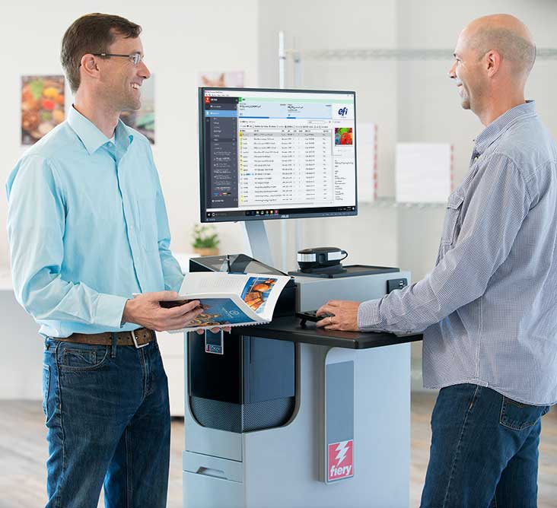
What is the Fiery FS300 Pro platform?
“A platform for the next decade”
  It’s all about the users
    Innovation in almost every single touch point the user has with Fiery®
    New features in the key areas users care about: color, productivity, usability, and integration
  Driving Fiery Driven™ presses
    Cutsheet, high-speed continuous feed, B1 folding carton, and corrugated
Notes:
Let’s first answer “What is the Fiery FS300 Pro”? And what does FS300 Pro mean for users?
First of all, Fiery FS300 Pro is not just system software, it is a platform. It’s a platform that converges all aspects of a digital front end, or DFE, solution. Fiery DFEs include hardware, software, workflow solutions, and more.
FS300 Pro platform defines and sets the direction for Fiery servers in the next decade by:
Focusing on users with a redesign and innovation in almost every single touch point the user has with Fiery. This includes everything from exterior design that incorporates a Fiery QuickTouch display to interact with the Fiery server, to the furniture stand, and all aspects of user interface in Command WorkStation.
And, of course, FS300 Pro adds new features in the key areas users care about: color, productivity, usability, and integration.
In addition to that, FS300 Pro drives multiple print technologies, not only cutsheet toner presses. With ever-increasing demands for faster thoughput in production printing, Fiery is now driving very high-speed presses such as the Xerox Trivor 2400, Landa’s Nanographic presses, our own Nozomi for corrugated, and many other engines.

Slide 3
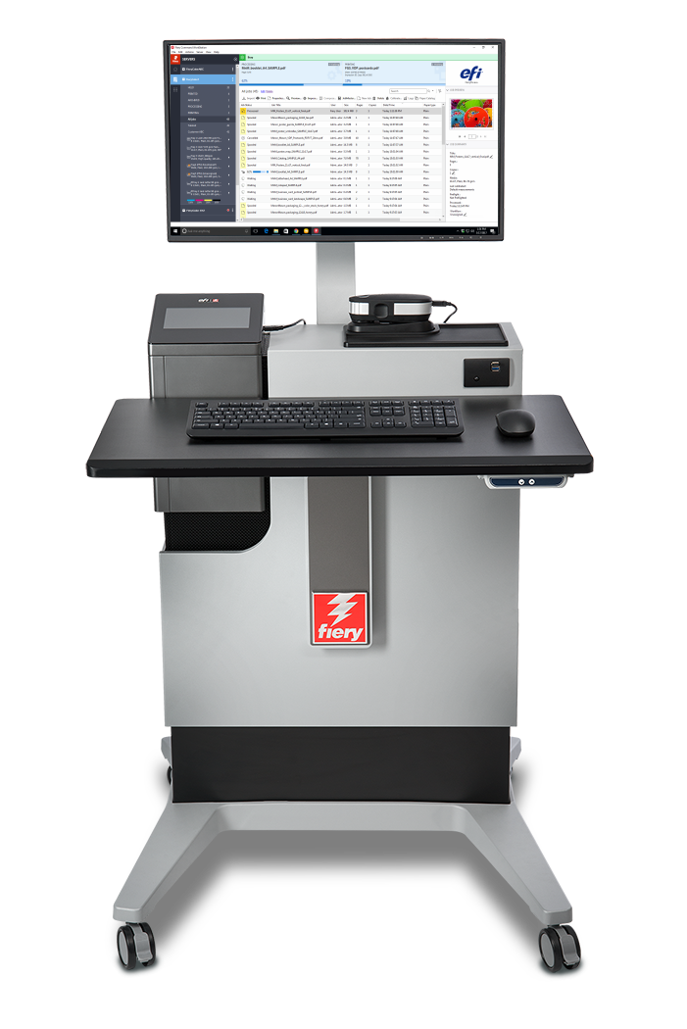
New platform innovation
Fiery FS300 Pro system software
Fiery Command WorkStation®
Fiery NX and XB platforms
Fiery makeready workflow
Notes:
As you can see in this slide, all the latest innovations ship with this new Fiery DFE platform.
A new user interface, with Command WorkStation 6
A new industrial design and hardware specs for Fiery NX and Fiery XB servers
A new codebase with FS300 Pro system software
And major enhancements to Fiery makeready solutions

Slide 4

Fiery FS300 Pro new features
  7 color support
  Spot color group priority
  Grayscale input profile
  Grayscale composite overprint
  Fiery ImageViewer
  Object inspector
  Total area coverage
New hardware
APPE 4*
HyperRIP enhancements
Fast reprint
Fiery Impose:
Gangup automation enhancements
  Auto page rotation
  Presets for marks
  Fiery Command WorkStation 6
    Previews for all jobs
    Automatically remove rasters
  Fiery NX design
    Fiery QuickTouch
    Fiery NX Station
Fiery JobMaster:
Image stamping
Import scanned pages
Page offset
Other makeready enhancements
  Windows 10
  Security enhancements
  Automatic system backups
  Fiery updates from Command WorkStation
  802.1x EAP-TLS
  Automatic proxy configuration
  Integration enhancements
* APPE is updated with enhancements and service releases on an ongoing basis.
Notes:
Another way to see what’s new in FS300 Pro across print technologies, is to look at areas users care about the most.
As you can see, all areas are represented with new features to reinforce Fiery leadership in the print industry.
Let’s examine these new features in the following slides.

Slide 5

Fiery Command WorkStation 6
The most intuitive print job management interface for Fiery servers
Notes:
Let’s start first with Command WorkStation 6 — the new user interface for print job management for Fiery DFEs.

Slide 6
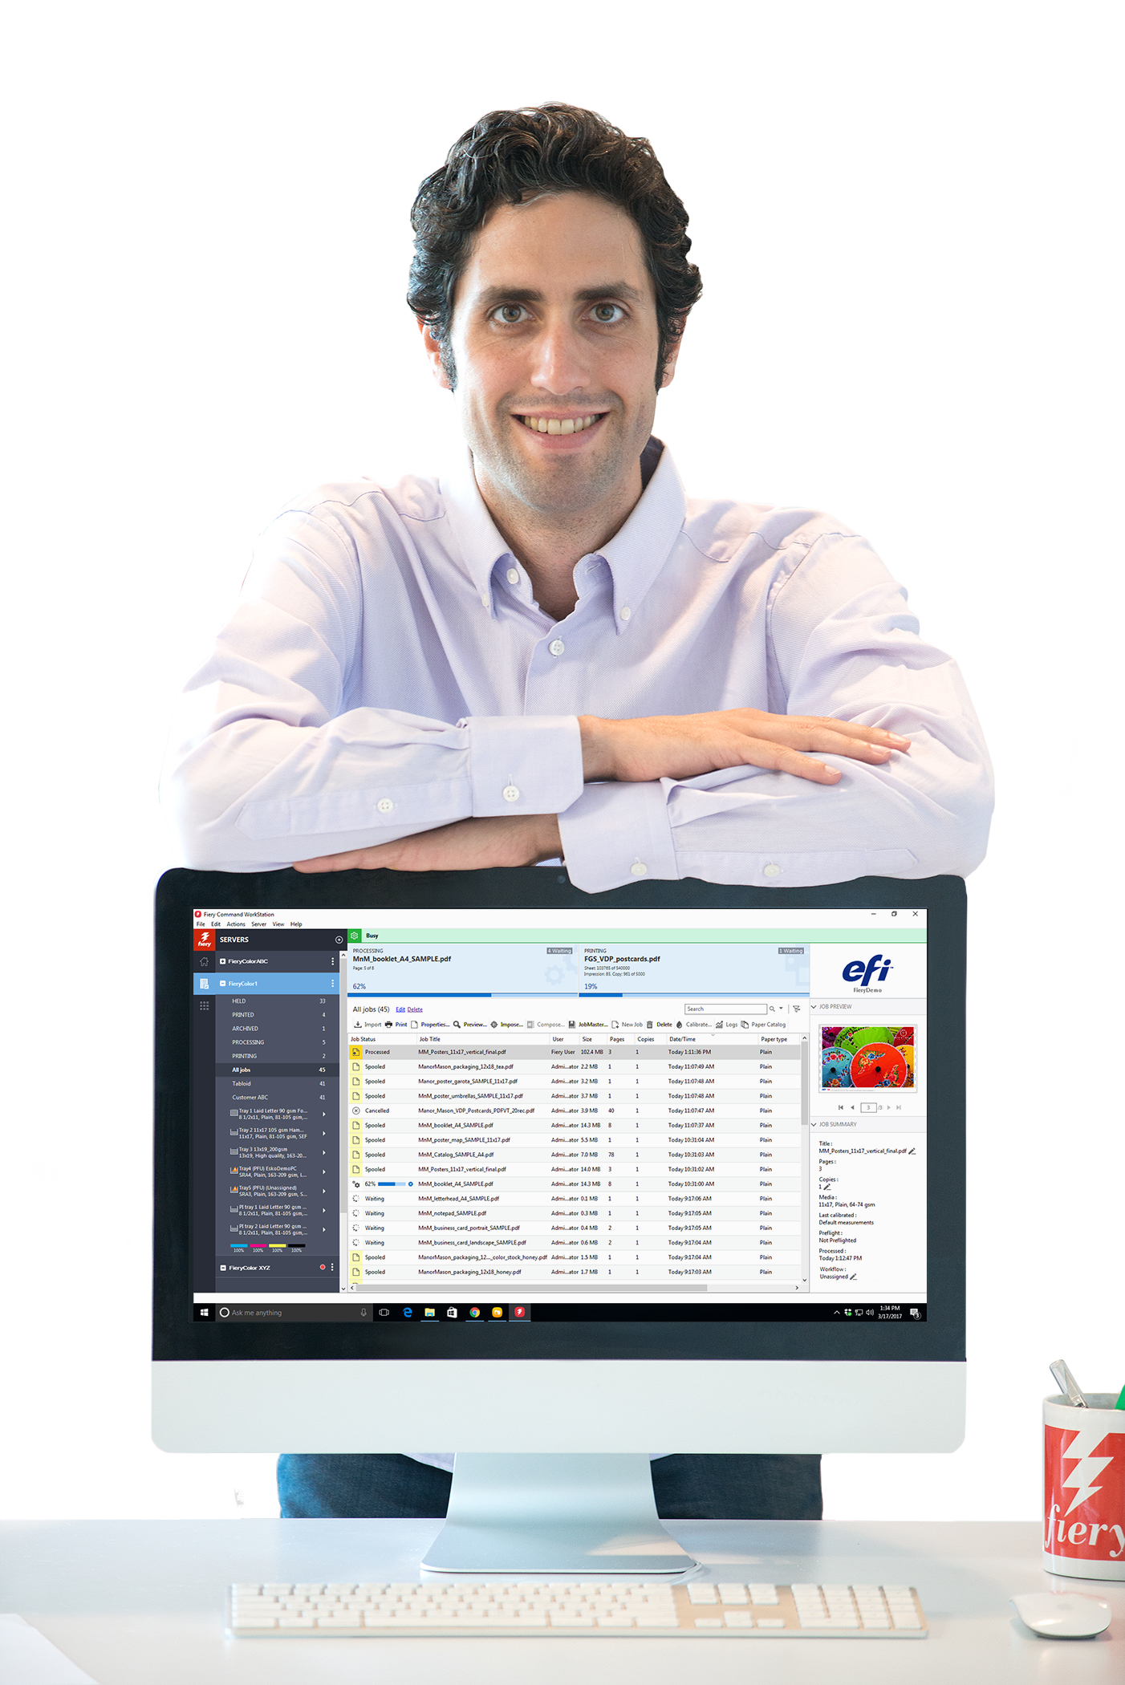
Fiery Command WorkStation 6
Manage print jobs faster,
boost print production
More intuitive and easy to use
More efficient and productive
New tools for managers
Smooth and quick upgrade process
Future ready
Access to full presentation
Notes:
Version 6 offers better usability and higher efficiency. And all you have to do to get these benefits is to download it for free from efi.com/cws.
In addition to operator benefits, there are also new tools for production managers.
Version 6 works with Fiery servers running Fiery System 10 and above, and also provides future connectivity to Fiery servers driving wide- and superwide-format printers.

Slide 7
New features in version 6
Easy transition from version 5
Smooth and quick upgrade process
Welcome tour
More intuitive and easy to use
Modern and clean user interface
More efficient and productive
Job preview for all jobs*
Automatically remove rasters*
Fast reprint*
Job search functions
  Simple search
  Advanced search
  Custom views and filters
Color settings in Job Properties
Set defaults
  Color management defaults
Inline editing
New tools for production managers
Home view
  Server status
  Quick production metrics
Fiery updates
Set defaults
*New features for FS300 Pro servers only
Notes:
The list of new features has some that were specifically designed to work with FS300 Pro servers or later.
Job preview for all jobs works only on external Fiery servers running Fiery FS300 Pro
Automatically remove rasters and fast reprint is supported by both, external and embedded servers running Fiery FS300 Pro/FS300.

Slide 8
New features in makeready solutions
Fiery Impose Fiery Compose Fiery JobMaster | Usability enhancements Easier preference setting, preserve window and pane size, show media color, enhanced page insertion, faster job saves, quicker sheet size selection Acrobat DC Professional and PitStop Edit 13
Fiery Impose | Gangup automation by media size Auto page rotation Presets for marks Mixed media for VDP booklet covers Japanese crop mark style workflow automation Free 30-day trial
Fiery JobMaster | Image stamping Import scanned pages Page offset Free 30-day trial
*New feature for FS300 Pro servers only
Access to full presentation
Notes:
In the list of makeready new features, there is also one feature that is specific to FS300/FS300 Pro servers (embedded or external) — the ability to save Impose templates containing Japanese crop marks. This allows users to automate job layout preparation using this type of crop mark.

Slide 9
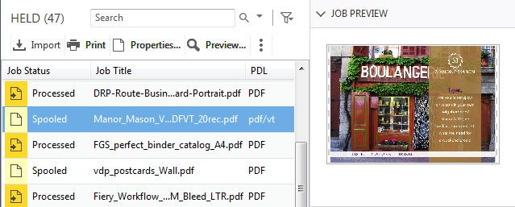
Job preview for all jobs
Identify jobs faster
  No performance
  impact
  First page preview only
  Supported file formats:
    PS, PDF, PDF/VT, TIF, EPS
  Available for external Fiery servers only
Notes:
Users with external Fiery servers running FS300 Pro and Windows 10 can now preview all jobs. This helps operators identify and find jobs faster.
Previewing jobs doesn’t impact the Fiery server performance, so the feature is always on. The preview lets operators see the first page of the job.
While the feature doesn’t work with PPML files, it does work with PostScript, PDF, PDF/VT, TIF, and EPS files.

Slide 10
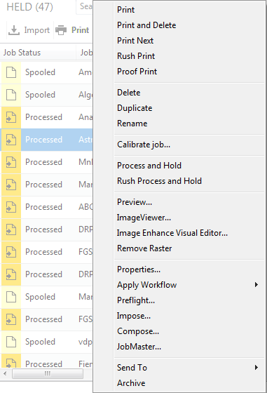
Automatically remove rasters
One-click access to makeready settings
Processed jobs have the same job actions as spooled jobs
Notes:
The next feature is called “automatically remove rasters.”
With this feature, users who want to resume the job layout and makeready settings after processing a job, will no longer need to select “Remove Raster” before accessing Impose, Compose, or JobMaster. The Fiery server will “Remove Raster” automatically if any of those makeready options are selected from the Actions menu.
This shortens access to makeready settings from three clicks to one, and offers a more intuitive experience since users will see job actions for processed jobs that are consistent with those for spooled jobs.

Slide 11
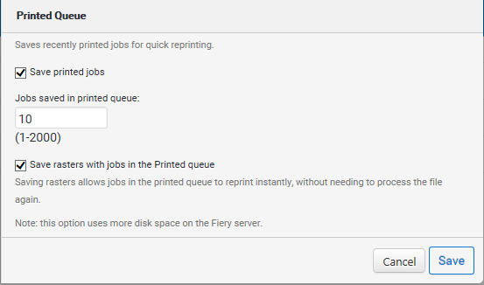
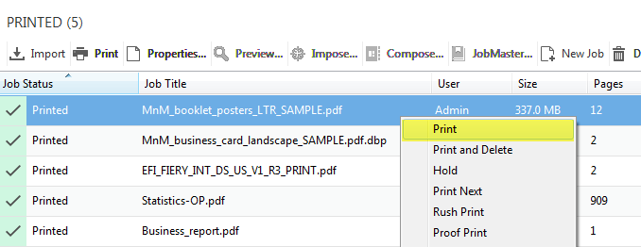
Fast reprint
Reprint jobs without re-RIPing
Use the new option
in Configure to save
raster files with jobs in
the PRINTED queue
Enable “Save rasters with jobs in Printed queue” in Configure
Notes:
Fast Reprint can save a lot of time.
Using this feature, administrators can keep the raster files for jobs in the PRINTED queue. When the print service provider needs to reprint those jobs, the files start printing the instant jobs are sent to print, without re-RIPping.
This feature is on by default and can be disabled from the Configure menu, as the screenshot on the right shows.
This is a great feature when users need to print one copy of a job as a proof, and then print it again for production. All they have to do is just change the copy count.

Slide 12
Fiery NX and XB platforms

Slide 13
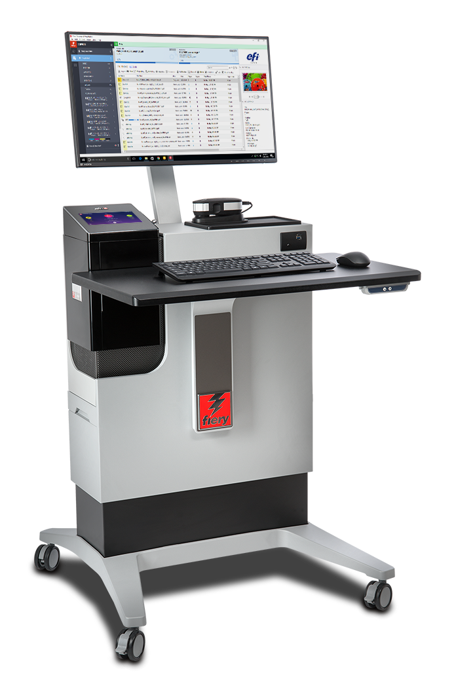
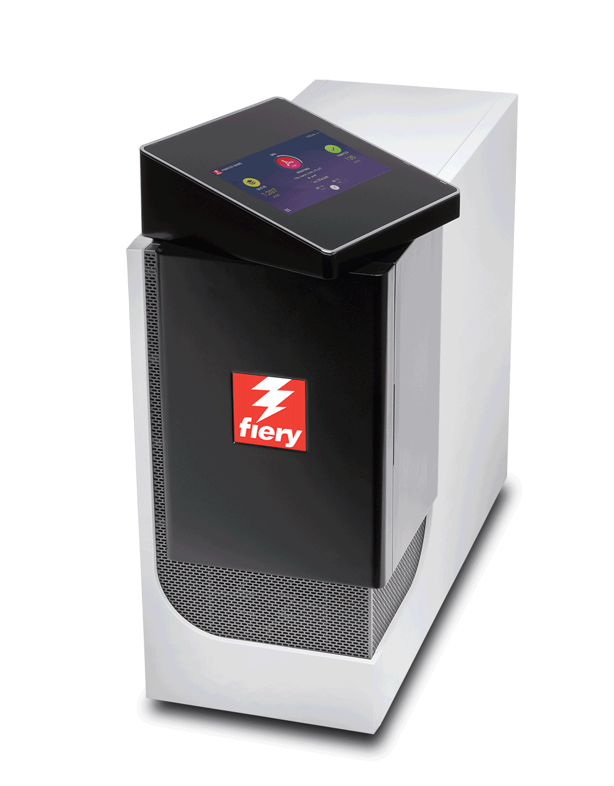
New Fiery NX Premium and NX Pro
New NX server industrial design
New touchscreen display panel
with Fiery QuickTouch software
Efficient operation with new
NX Station
Access to Fiery Production Solutions webpage
Rotating touchscreen panel
Notes:
FS300 Pro servers feature the cutting-edge and innovative Fiery NX industrial design that was precisely crafted with the Fiery operator in mind.
The Fiery NX Premium is the high-end Fiery DFE that replaces the Fiery QX100 servers. The Fiery NX Pro is the server that replaces the Fiery Pro 80 hardware platforms.
The new server design includes the Fiery QuickTouch interface that helps users speed up job and device management. The touchscreen display rotates and provides intuitive system installation, backup, and diagnosis; plus easy access to and faster views of job status information. It also includes 3 USB ports, conveniently located on the side of the display
Either the Fiery NX server (Premium or Pro) can be placed inside the new Fiery NX Station to provide a centralized work station that adapts to different print production environments. The work stations come in two versions: The NX Station GL is the basic configuration, and the NX Station LS adds an adjustable-height workspace, a larger monitor, a proximity sensor that wakes up the Fiery server as soon as it identifies someone approaching, and tidy power cable storage.

Slide 14
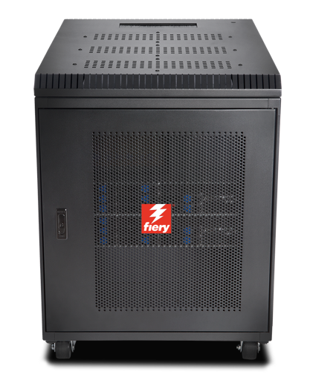
Fiery XB
Designed for a wide range of markets
  Packaging
  Folding carton, corrugated, and flexible packaging
  Commercial print
  Transaction/IPDS, direct mail
High-performance, bladed architecture
  Up to 1.8m x 3m sheet, or 1m-wide web
  Up to 15000 SPH (B1, 1200x1200 dpi)
  Up to 200 mpm roll-fed (1m 1200x1200 dpi)
Notes:
The Fiery XB hardware platform is designed for a wide variety of high-production markets such as packaging, commercial print, and transactional.
Its high-performance, bladed architecture fulfills demands for high throughput and a wide range of paper widths.

Slide 15
Fiery FS300 Pro system software
Print businesses stay competitive with unmatched productivity, color quality, and integration
Notes:
This section covers the new features in the Fiery system software — Fiery FS300 Pro

Slide 16
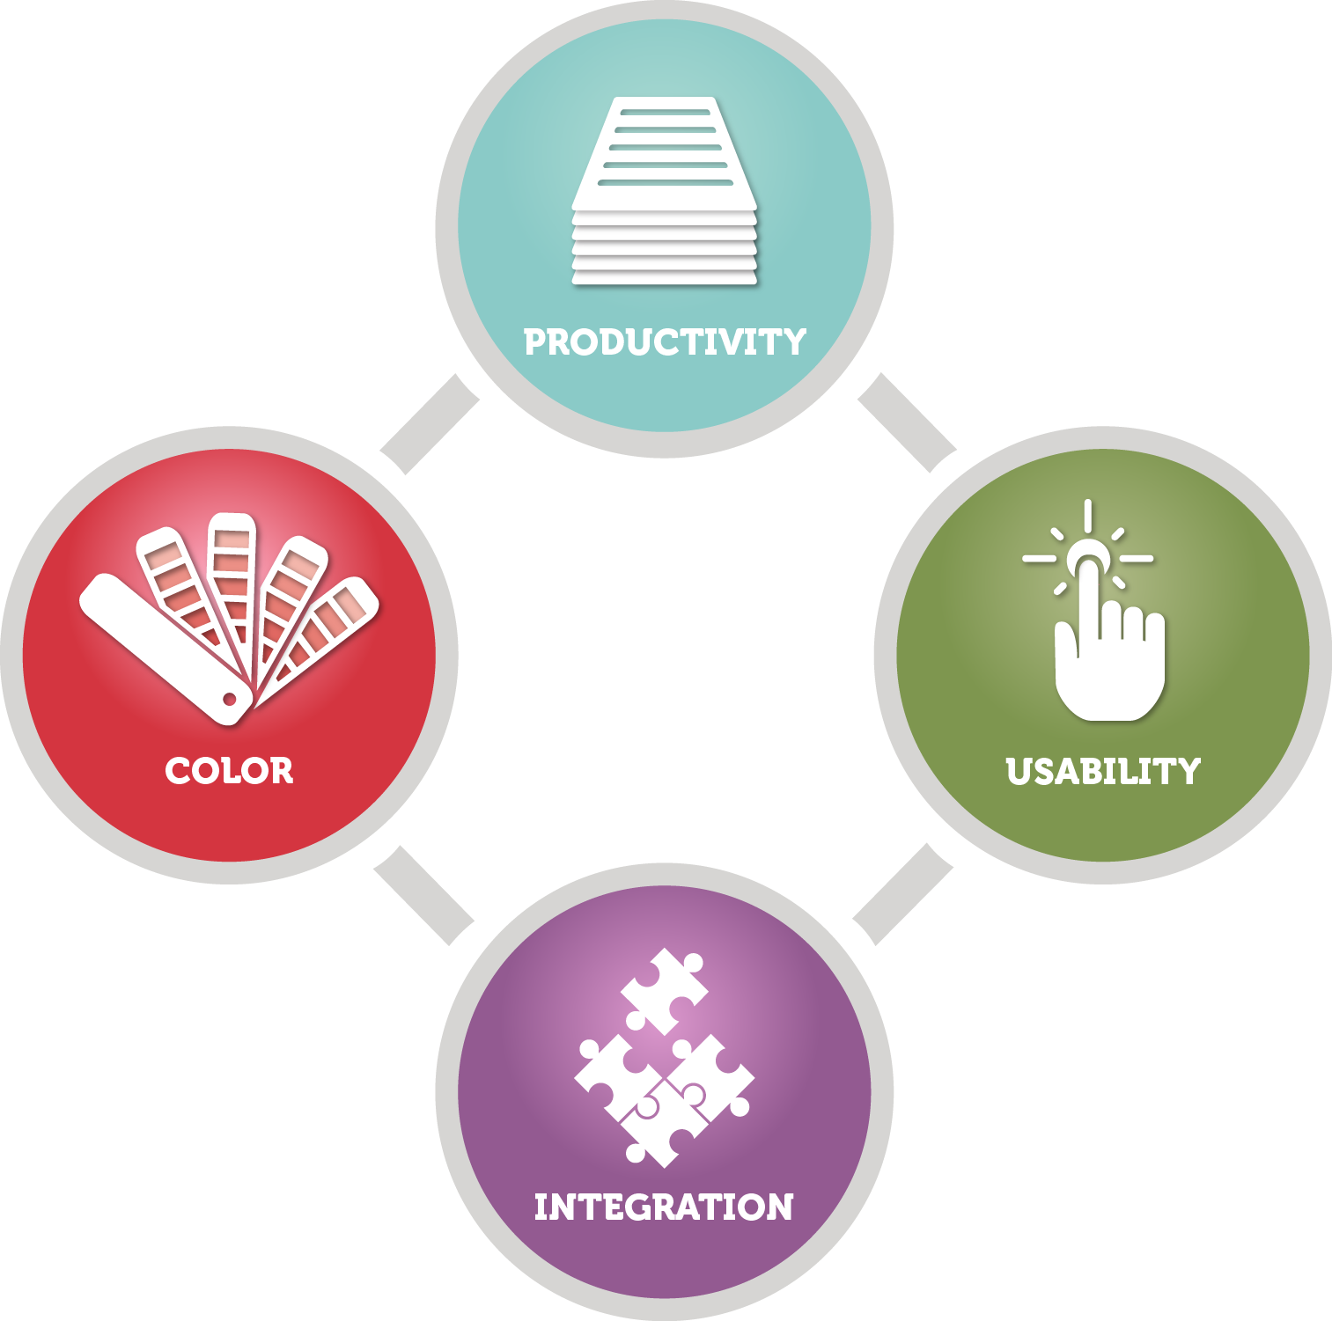
FS300 Pro areas of focus
Output quality control
Performance
Security
Serviceability
Integration
Notes:
The new features target the areas users care most about:
Output quality control
Performance
Security
Serviceability
Integration

Slide 17

Output quality control
Fiery Spot-On™
  Spot color group priority
Fiery ImageViewer
  Object Inspector
  Total Area Coverage
Notes:
There are several new features that offer new tools to enhance output quality control, and are great additions for professional prepress environments:
The Fiery Spot-On feature adds spot color group priority
Fiery ImageViewer, part of Fiery Graphic Arts, Premium Edition and Fiery Productivity Package, adds object inspector and total area coverage features

Slide 18


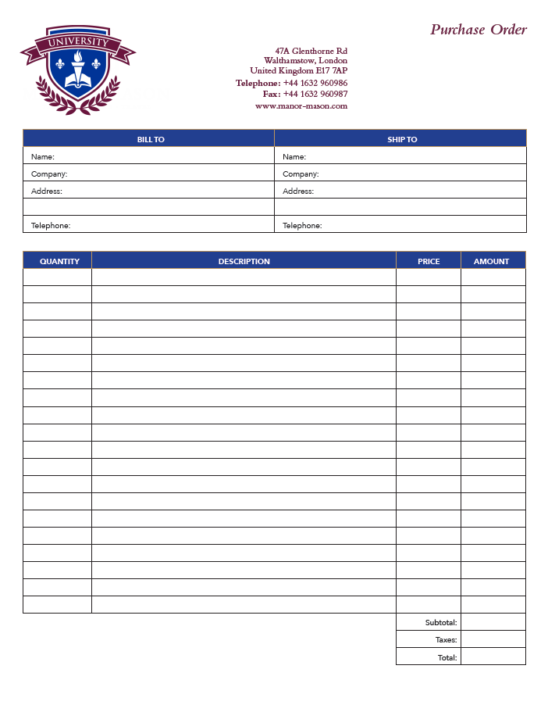

Spot color group priority
Satisfy custom color preferences with ease
Define color library order by job
Saves time reordering color groups in Device Center
Requires Fiery Spot-On
Notes:
Spot color group priority is a feature that enables users to easily ensure that custom spot color representation is honored to satisfy print buyer’s expectations.
This is a very useful feature for print environments where Fiery users edit the appearance of specific spot colors to match the expectations of print buyers. These spot color edits are saved as new groups of colors using the Spot-On interface in Device Center.
But sometimes different print buyers want different edits to the same spot colors, or one buyer may request an adjustment — but other print buyers like the default color mapping of the spot color.
The spot color group priority feature allows the Fiery user to set which of the color libraries in Spot-On takes priority for a given job from the Color tab in Job Properties or Fiery driver. This means that if the requested spot color adjustment for one customer is created in a custom spot color library, the library can be given priority when printing that customer's jobs without forcing the spot color edit for all future print jobs.
This feature can save a lot of time for users who no longer need to constantly check on the order of the color libraries or groups in Spot-On.

Slide 19
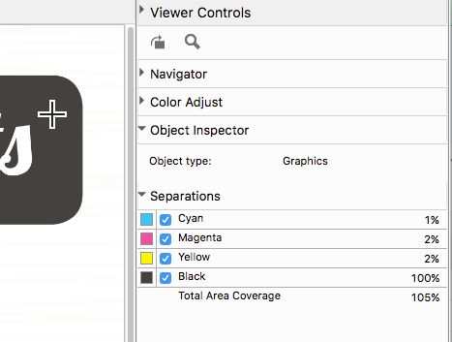
Object Inspector
Shows object type for raster pixels
  Text, graphic, image, smooth shade and edge
Helps identify problems with object-based settings:
  Print gray using black only
  Edge enhancement effects
    For example, Dynamic HD Text and Graphics
  Object-based raster
Reduces troubleshooting time
Requires Fiery Graphic Arts Package, Premium Edition or Fiery Productivity Package
Notes:
Object Inspector, part of Fiery ImageViewer 3.0, helps identify imaging problems related to specific object types. The tool identifies what type of page object was in the original page description file before it was RIPped. It can identify object types including image, graphic, smooth shade, text, and edge.
The feature allows the user to troubleshoot image quality issues related to page object type more efficiently. Some examples include the ability to:
Identify a page object that may fail to use black only because gray settings in Job Properties are not set to use black only for that object type.
Identify cases where a color mismatch within a page is related to how each object type is processed, such as halftone screen. These color mismatches are hard to identify since the color looks identical in the raster, but they print with a mismatch when they are screened on the print engine.
Determine where pixels are being tagged for edge enhancement by features such as Fiery Dynamic HD Text and Graphics or engine-specific edge-enhancement technologies.

Slide 20

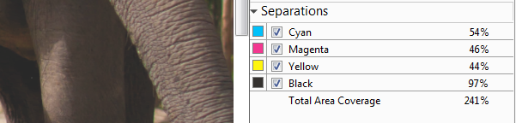
Total Area Coverage
Shows sum of separation values
Helps identify areas where total area coverage limit is reached
Can be used to troubleshoot imaging issues such as lack of shadow detail
Requires Fiery Graphic Arts Package, Premium Edition or Fiery Productivity Package
Notes:
Total Area Coverage, also part of Fiery ImageViewer 3.0, reports the sum of color separation values for a pixel. This can help users troubleshoot image quality issues related to toner or ink coverage, and determine whether the toner or ink limit has been reached.

Slide 21
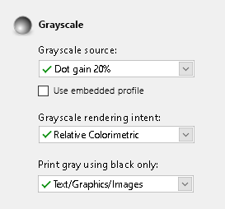
Grayscale input profile
Match expected print appearance for grayscale images, vector or graphic objects
Specify color rendering controls the same way as with RGB and CMYK
Grayscale settings in Color tab in Job Properties and driver
Notes:
Previous Fiery servers render grayscale objects using the CMYK source profile, which can result in an unexpected and often incorrect appearance.
This feature provides users with specific control over the color management of grayscale page objects by adding grayscale settings in the Color tab in Job Properties and the driver.
When grayscale page objects are created in a design application such as Adobe Photoshop, a grayscale ICC profile is used to define their intended appearance. This feature lets the user set the same profile to be used on the Fiery server so that the expected appearance can be maintained when printing.

Slide 22

Grayscale composite overprint
Black and white servers can honor transparencies and overprints in grayscale elements
Print jobs the way the designer expected them to appear without unwanted knock-outs
Notes:
Graphic designs are commonly created using objects that overlap each other, and the design requires that an object on top of another page object shows through (or overprints) what is behind it so that colors or patterns in the foreground object are blended with colors or patterns of the background object it overlaps. To get these overprints to print properly, a DFE must be configured to process the overprints and reflect those effects in the printout. Fiery FS300 Pro servers now honor the overprint settings on both on black-and-white servers and on color servers set to grayscale mode. This feature was added with the FS200 Pro in Fiery color servers.
The grayscale composite overprint setting can be found in the Image tab of Job Properties and the driver for black-and-white servers.

Slide 23

Performance enhancements
HyperRIP optimizations
Fast reprint
Next-generation hardware
  NX Pro and Premium servers
  XB servers
See HyperRIP video
Process jobs 55% faster
Notes:
Fiery FS300 Pro servers process jobs faster with innovative technology:
Fiery NX Premium servers include Fiery HyperRIP, which can process more file formats in this mode
All Fiery FS300 Pro servers include fast reprint from Command WorkStation 6: This features enables jobs in the PRINTED queue to start printing the instant they are sent to print again
Fiery FS300 Pro servers ship with new hardware platforms which deliver faster processing performance

Slide 24
File formats supported in single-job mode
File type | Plain | Duplex | XObjects / Form Caching | Mixed Media | Control Bar | Print range Page/Record | Impo-sition | Post-flight | Direct Queue
CPSI workflow
PDF | Yes | Yes | Yes | Yes | Yes | Yes | No | No | Yes
PS | Yes | Yes | Yes | Yes | Yes | Yes | No | No | No
QuickDoc Merge | Yes | Yes | Yes | Yes | Yes | Yes | No | No | No
PDF/VT | Yes | Yes | Yes | Yes | Yes | Yes | No | No | Yes
PPML | Yes | Yes | Yes | Yes | Yes | Yes | No | No | No
VPS | Yes | Yes | Yes | Yes | Yes | Yes | No | No | No
VIPP | Yes | Yes | Yes | Yes | Yes | Yes | No | No | No
FreeForm Master | No | No | No | No | No | No | No | No | No
FreeForm Variable | Yes | Yes | Yes | Yes | Yes | Yes
TIF | No | No | No | No | No | No | No | No | No
EPS | No | No | No | No | No | No | No | No | No
APPE workflow
PDF | Yes | Yes | Yes | Yes | Yes | Yes | No | No | Yes
PDF/VT | Yes | Yes | Yes | Yes | Yes | Yes | No | No | Yes
PCL workflow
PCL | No | No | No | No | No | No | No | No | No
NO
FS200 Pro table
FS300 Pro table
Notes:
This slide shows the file formats not supported by HyperRIP before FS300 Pro in single-job mode.

Slide 25
File formats supported in single-job mode
File type | Plain | Duplex | XObjects / Form Caching | Mixed Media | Control Bar | Print range Page/Record | Impo-sition | Post-flight | Direct Queue
CPSI workflow
PDF | Yes | Yes | Yes | Yes | Yes | Yes | No | No | Yes
PS | Yes | Yes | Yes | Yes | Yes | Yes | No | No | No
QuickDoc Merge | Yes | Yes | Yes | Yes | Yes | Yes | No | No | No
PDF/VT | Yes | Yes | Yes | Yes | Yes | Yes | No | No | Yes
PPML | Yes | Yes | Yes | Yes | Yes | Yes | No | No | No
VPS | Yes | Yes | Yes | Yes | Yes | Yes | No | No | No
VIPP | Yes | Yes | Yes | Yes | Yes | Yes | No | No | No
FreeForm Master | No | No | No | No | No | No | No | No | No
FreeForm Variable | Yes | Yes | Yes | Yes | Yes | Yes
TIF | No | No | No | No | No | No | No | No | No
EPS | No | No | No | No | No | No | No | No | No
APPE workflow
PDF | Yes | Yes | Yes | Yes | Yes | Yes | No | No | Yes
PDF/VT | Yes | Yes | Yes | Yes | Yes | Yes | No | No | Yes
PCL workflow
PCL | No | No | No | No | No | No | No | No | No
FS300 Pro table
Notes:
As you can see, FS300 Pro supports many more formats in single-job mode.

Slide 26
Security enhancements
Windows 10 IoT Enterprise
  Malicious application protection with Windows Defender SmartScreen
  Man-in-the-middle protection with SMB hardening and enterprise certificate pinning
  Malware and antivirus protection with Windows Defender and Windows Data Execution Prevention
Notes:
Fiery external servers ship with the Microsoft Windows 10 IoT Enterprise 2016 LTSB edition (Windows 10) operating system, which contains the latest security protections. These key features address security protections. See the Fiery FS300 Pro Security white paper for more information.
Enable Windows Defender SmartScreen feature to prevent malicious applications from being downloaded. This additional security feature may affect Fiery server performance and is not turned on by default.
Windows 10 comes with SMB hardening for SYSVOL and NETLOGON shares, which helps mitigate man-in-the-middle attacks for Fiery servers joined to a domain.
Windows Defender Antivirus helps keep devices free of viruses and other malware. Fiery server is configured with the feature turned on to scan c:\, but not e:\ to minimize performance impact. Administrators can configure Windows Defender to scan e:\ if desired.
Windows Data Execution Prevention (DEP) can be enabled for Windows programs and services to help prevent malware from using the memory manipulation technique.
Windows 10 has better memory protections for heap and kernel pools to help prevent exploitation of memory.
Enterprise certificate pinning helps prevent man-in-the-middle attacks. This is an enterprise feature. A Fiery server has to join a domain to enable the feature.

Slide 27
Serviceability improvements
Minimize production interruptions
Fiery updates
  Easily keep Fiery servers up to date
Automatic system backups
Fast recovery after a restore
Notes:
Serviceability improvements in Fiery FS300 Pro offer administrators, analysts, and technicians better ways to ensure that Fiery servers are always up to date, minimize downtime, and provide fast recovery of Fiery servers.
Fiery Updates is a new feature introduced with Command WorkStation 6. Because timely software updates are critical for optimal operation of Fiery servers, Command WorkStation offers administrators an easy way to get notifications, downloads, and installation of approved and released Fiery system updates.
Administrators access Fiery Updates through the Device Center and can perform updates, even from remote client computers. This way, they can still update even Fiery servers that may not be connected to the internet. At the Fiery Updates screen, administrators can also see all the patches and service packs available and waiting to be installed for external or embedded servers.
Fiery Updates ensures the right sequence of patch updates to guarantee effective installation and avoid incompatibilities.

Slide 28
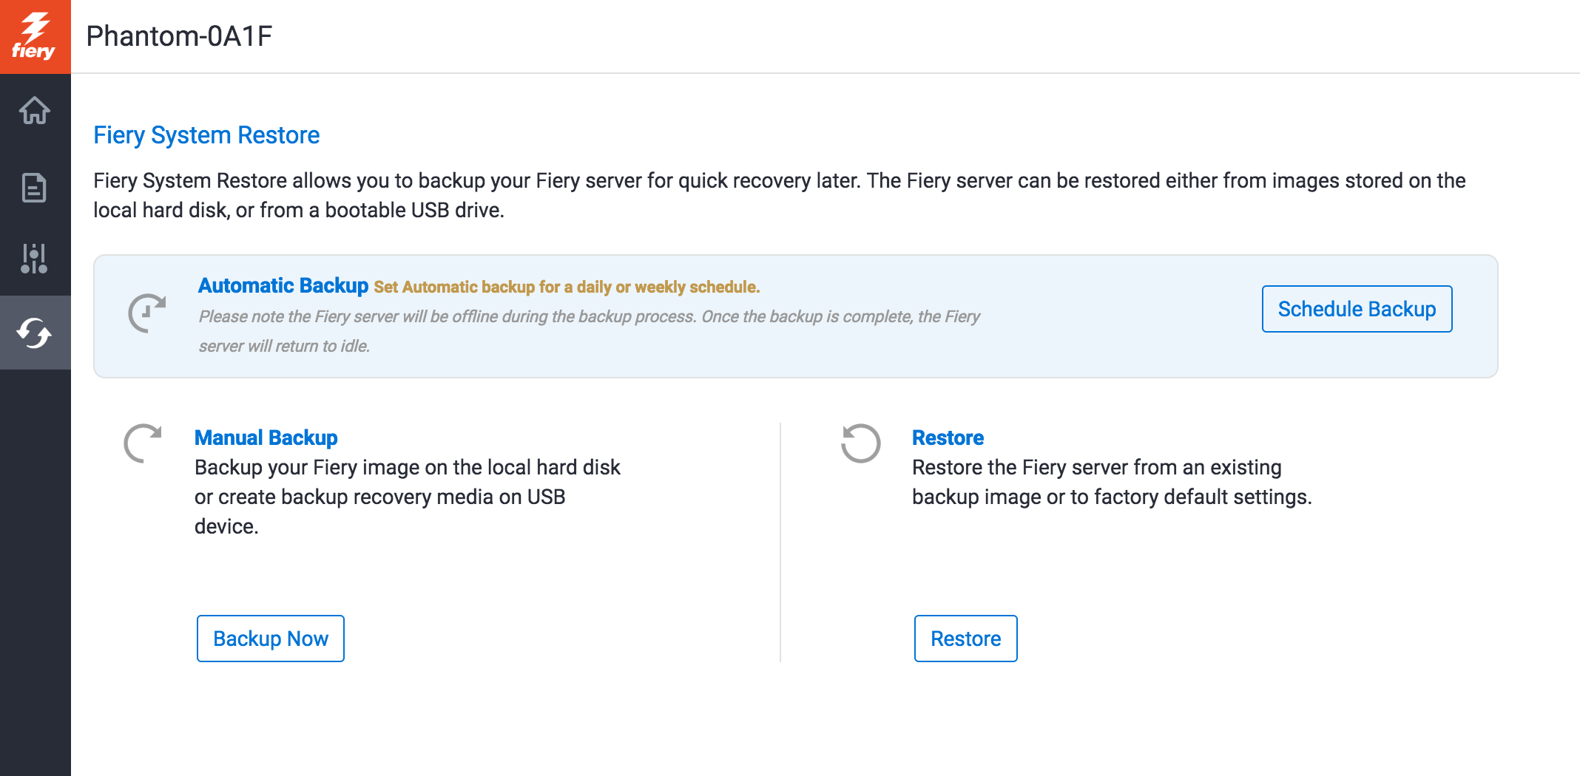
Automatic system backups
Setup a backup schedule from Fiery QuickTouch and WebTools
Restore the Fiery server in less than an hour
  1/8th of the time it takes to load from a DVD kit
No DVD kit required
Notes:
Fiery administrators now have an easy way to schedule automatic Fiery system backups to guarantee fast recovery — and without the need to restore from a DVD media kit.
They can manage backups using Fiery WebTools or the Fiery QuickTouch interface. With these tools, it can take less than an hour to restore from a backup — 1/8th of the time it takes to restore from a DVD kit.

Slide 29
Integration enhancements
New APIs and usability improvements easily integrate in-house applications in Fiery API v4
New JDF-enabled Fiery features Fiery JDF v1.5
  EFI AutoCount
  EFI Quick Print Suite
  Kodak Prinergy 8.1
Notes:
Fiery API and Fiery JDF are always improving to bring usability enhancements and tighter integration with EFI web-to-print and MIS systems plus third-party prepress workflow solutions.

Slide 30
The value of Fiery FS300 Pro
Leading innovation in areas important to customers
Driving the industry’s most advanced digital presses
Notes:
Fiery servers bring innovation to areas important to customers and continue the evolution of printing by driving the most advanced digital presses.

Slide 31
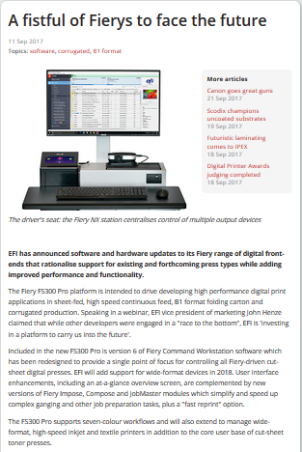
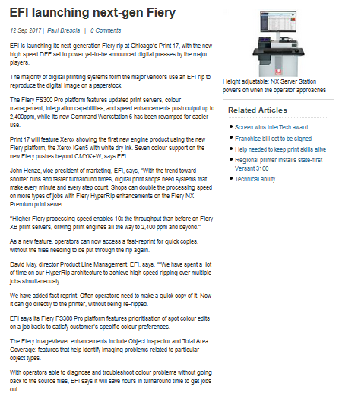
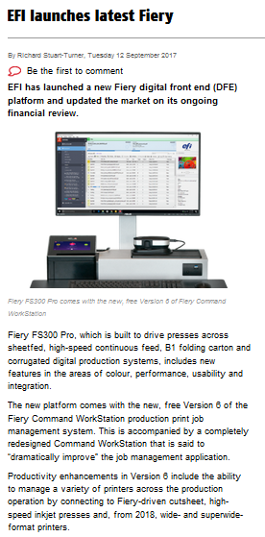
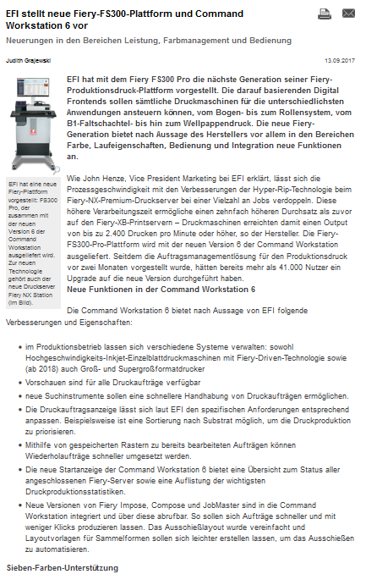
Public release
EFI Press release:
  Europe and US: September 11th
EFI press release
Press articles
What They Think
Print Show Daily
Deutscher Drucker
PrintWeek
Australian Printer
Digital Printer
Notes:
This slide gives you links for direct access to the EFI press release posted in September 2017, and to the various press articles all around the globe.

