Slide 1
Fiery FS300 Pro 新增功能
发言者姓名
标题
Notes:
This presentation will give you a closer look into what’s new in this new platform and offers the marketing positioning and overall message for the launch of Fiery FS300 Pro.

Slide 2
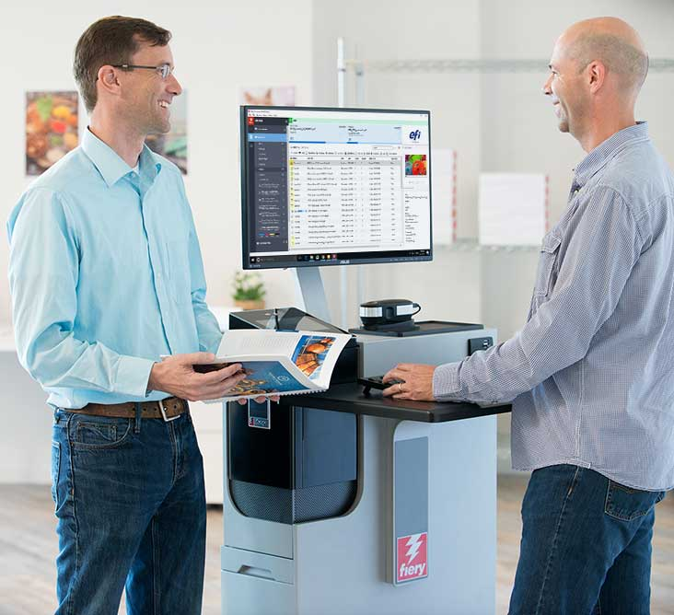
什么是 Fiery FS300 Pro 平台？
“面向未来十年的平台”
一切以用户为中心
围绕用户使用 Fiery® 时进行的几乎每一个操作进行创新
用户关注的主要领域（颜色、生产效率、 易用性和集成性）的新功能
驱动 Fiery Driven™ 印刷机
剪切纸张、高速持续送纸、B1 折叠纸盒和瓦楞纸箱
Notes:
Let’s first answer “What is the Fiery FS300 Pro”? And what does FS300 Pro mean for users?
First of all, Fiery FS300 Pro is not just system software, it is a platform. It’s a platform that converges all aspects of a digital front end, or DFE, solution. Fiery DFEs include hardware, software, workflow solutions, and more.
FS300 Pro platform defines and sets the direction for Fiery servers in the next decade by:
Focusing on users with a redesign and innovation in almost every single touch point the user has with Fiery. This includes everything from exterior design that incorporates a Fiery QuickTouch display to interact with the Fiery server, to the furniture stand, and all aspects of user interface in Command WorkStation.
And, of course, FS300 Pro adds new features in the key areas users care about: colour, productivity, usability, and integration.
In addition to that, FS300 Pro drives multiple print technologies, not only cutsheet toner presses. With ever-increasing demands for faster thoughput in production printing, Fiery is now driving very high-speed presses such as the Xerox Trivor 2400, Landa’s Nanographic presses, our own Nozomi for corrugated, and many other engines.

Slide 3
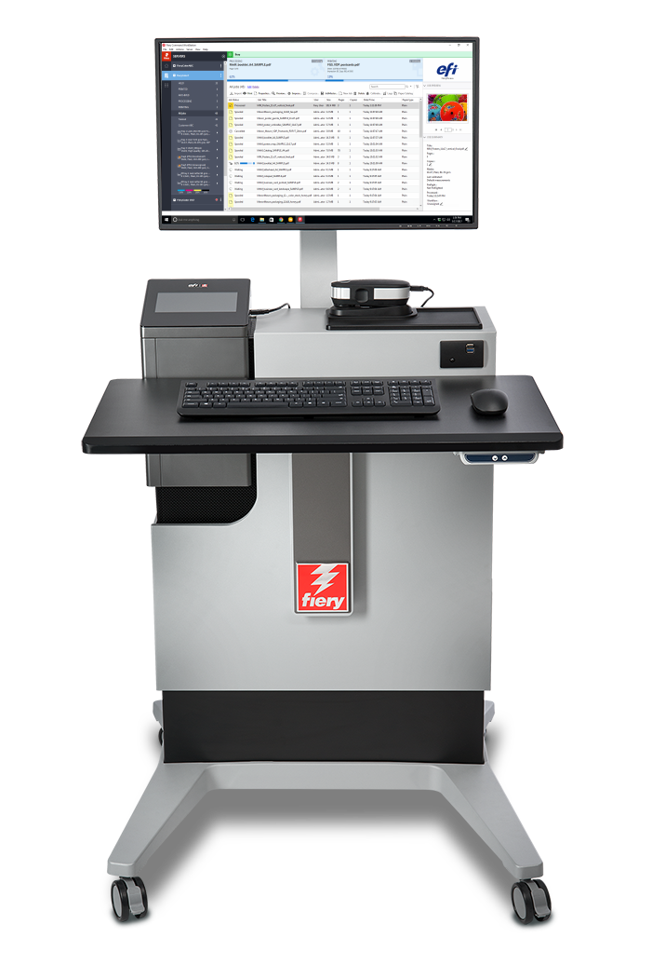
新平台创新
Fiery FS300 Pro 系统软件
Fiery Command WorkStation®
Fiery NX 和 XB 平台
Fiery 排版调整工作流程
Notes:
As you can see in this slide, all the latest innovations ship with this new Fiery DFE platform.
A new user interface, with Command WorkStation 6
A new industrial design and hardware specs for Fiery NX and Fiery XB servers
A new codebase with FS300 Pro system software
And major enhancements to Fiery makeready solutions

Slide 4
Fiery FS300 Pro 新功能
7 色支持
专色群组优先级
灰度输入特性档
Fiery ImageViewer
对象检查器
总区域覆盖
新硬件
APPE 4*
HyperRIP 增强功能
快速重新打印
Fiery Impose：
多联拼版自动增强
自动页面旋转
标记预设
Fiery Command WorkStation 6
所有作业预览
自动删除光栅
Fiery NX 设计
Fiery QuickTouch
Fiery NX Station
Fiery JobMaster：
图像印花
导入扫描页面
页面偏移
其他排版调整增强
Windows 10
安全性增强
自动系统备份
通过 Command WorkStation 实现 Fiery 更新
802.1x EAP-TLS
自动代理配置
集成增强
* APPE 已更新并支持持续发布的最新增强与服务。
Notes:
Another way to see what’s new in FS300 Pro across print technologies, is to look at areas users care about the most.
As you can see, all areas are represented with new features to reinforce Fiery leadership in the print industry.
Let’s examine these new features in the following slides.

Slide 5
Fiery Command WorkStation 6
适合于 Fiery 服务器的最直观打印作业管理界面
Notes:
Let’s start first with Command WorkStation 6 — the new user interface for print job management for Fiery DFEs.

Slide 6
Fiery Command WorkStation 6
更快速地管理打印作业，提高打印生产
更加直观、易用
更高效，更高产
适合于管理者的新工具
流畅、快速的升级流程
面向未来
访问完整演示
Notes:
Version 6 offers better usability and higher efficiency. And all you have to do to get these benefits is to download it for free from efi.com/cws.
In addition to operator benefits, there are also new tools for production managers.
Version 6 works with Fiery servers running Fiery System 10 and above, and also provides future connectivity to Fiery servers driving wide- and superwide-format printers.

Slide 7
版本 6 中的新功能
可以从版本 5 轻松过渡
流畅、快速的升级流程
欢迎介绍
更加直观、易用
现代化、简洁明了的用户界面
更高效，更高产
适合于所有作业的作业预览*
自动删除光栅*
快速重新打印*
作业搜索功能
简单搜索
高级搜索
自定义视图和筛选器
“作业属性”中的“颜色”设定
设为默认值
颜色管理默认值
内联编辑
适合于生产管理者的新工具
“主页”视图
服务器状态
快速掌握生产指标
Fiery 更新
设为默认值
*新功能仅适用于 FS300 Pro 务器
Notes:
The list of new features has some that were specifically designed to work with FS300 Pro servers or later.
Job preview for all jobs works only on external Fiery servers running Fiery FS300 Pro
Automatically remove rasters and fast reprint is supported by both, external and embedded servers running Fiery FS300 Pro/FS300.

Slide 8
排版调整解决方案中的新功能
Fiery Impose Fiery Compose Fiery JobMaster | 易用性增强功能 简化预置设置、保持窗口和窗格大小、显示纸张颜色、 增强的页面插入、更快地保存作业、更快地选择纸张大小 Acrobat DC Professional 和 PitStop Edit 13
Fiery Impose | 按纸张大小的多联拼版自动化 自动页面旋转 标记预设 用于 VDP 小册子封面的混合纸张 日式风格裁剪标记工作流程自动化 30 天免费试用版
Fiery JobMaster | 图像印花 导入扫描页面 页面偏移 30 天免费试用版
新功能仅适用于 FS300 Pro 服务器
访问完整演示
Notes:
In the list of makeready new features, there is also one feature that is specific to FS300/FS300 Pro servers (embedded or external) — the ability to save Impose templates containing Japanese crop marks. This allows users to automate job layout preparation using this type of crop mark.

Slide 9
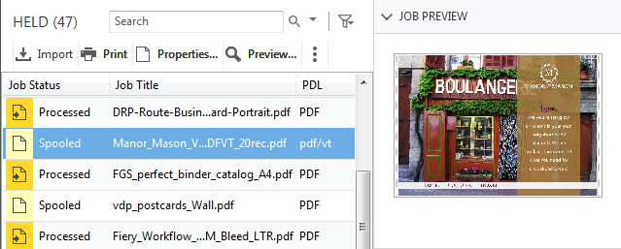
适合于所有作业的作业预览
更快速地识别作业
对性能毫无影响
仅第一页预览
支持的文件格式：
PS、PDF、PDF/VT、TIF、EPS
仅适用于外部 Fiery 服务器
Notes:
Users with external Fiery servers running FS300 Pro and Windows 10 can now preview all jobs. This helps operators identify and find jobs faster.
Previewing jobs doesn’t impact the Fiery server performance, so the feature is always on. The preview lets operators see the first page of the job.
While the feature doesn’t work with PPML files, it does work with PostScript, PDF, PDF/VT, TIF, and EPS files.

Slide 10
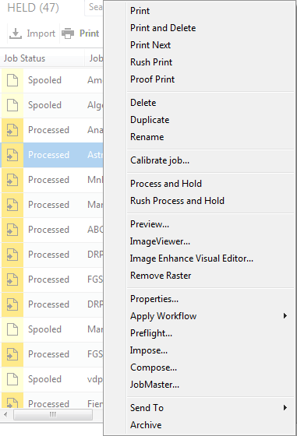
自动删除光栅
单击即可访问排版调整设定
已处理作业具有与已假脱机作业相同的作业操作
Notes:
The next feature is called “automatically remove rasters.”
With this feature, users who want to resume the job layout and makeready settings after processing a job, will no longer need to select “Remove Raster” before accessing Impose, Compose, or JobMaster. The Fiery server will “Remove Raster” automatically if any of those makeready options are selected from the Actions menu.
This shortens access to makeready settings from three clicks to one, and offers a more intuitive experience since users will see job actions for processed jobs that are consistent with those for spooled jobs.

Slide 11
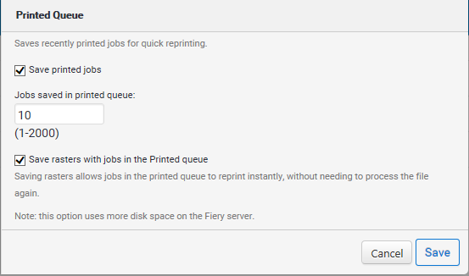
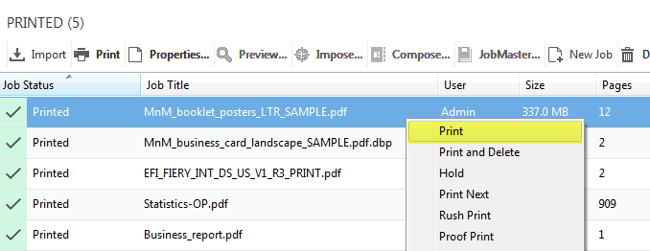
快速重新打印
无需重新进行光栅处理即可重新打印作业
使用 Configure 中的新选项，以保存光栅文件和已打印队列中的作业
在 Configure 启用“保存光栅数据和已打印队列中的作业”
Notes:
Fast Reprint can save a lot of time.
Using this feature, administrators can keep the raster files for jobs in the PRINTED queue. When the print service provider needs to reprint those jobs, the files start printing the instant jobs are sent to print, without re-RIPping.
This feature is on by default and can be disabled from the Configure menu, as the screenshot on the right shows.
This is a great feature when users need to print one copy of a job as a proof, and then print it again for production. All they have to do is just change the copy count.

Slide 12
Fiery NX 和 XB 平台

Slide 13
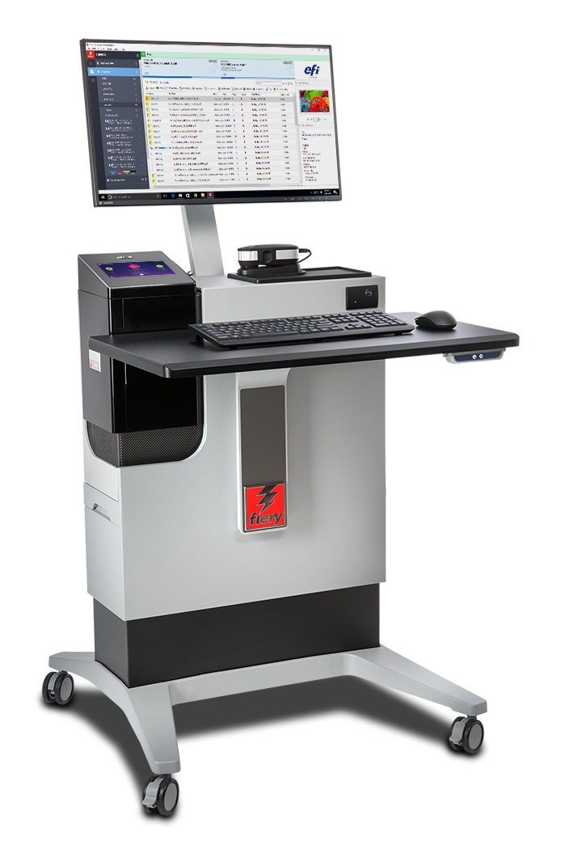
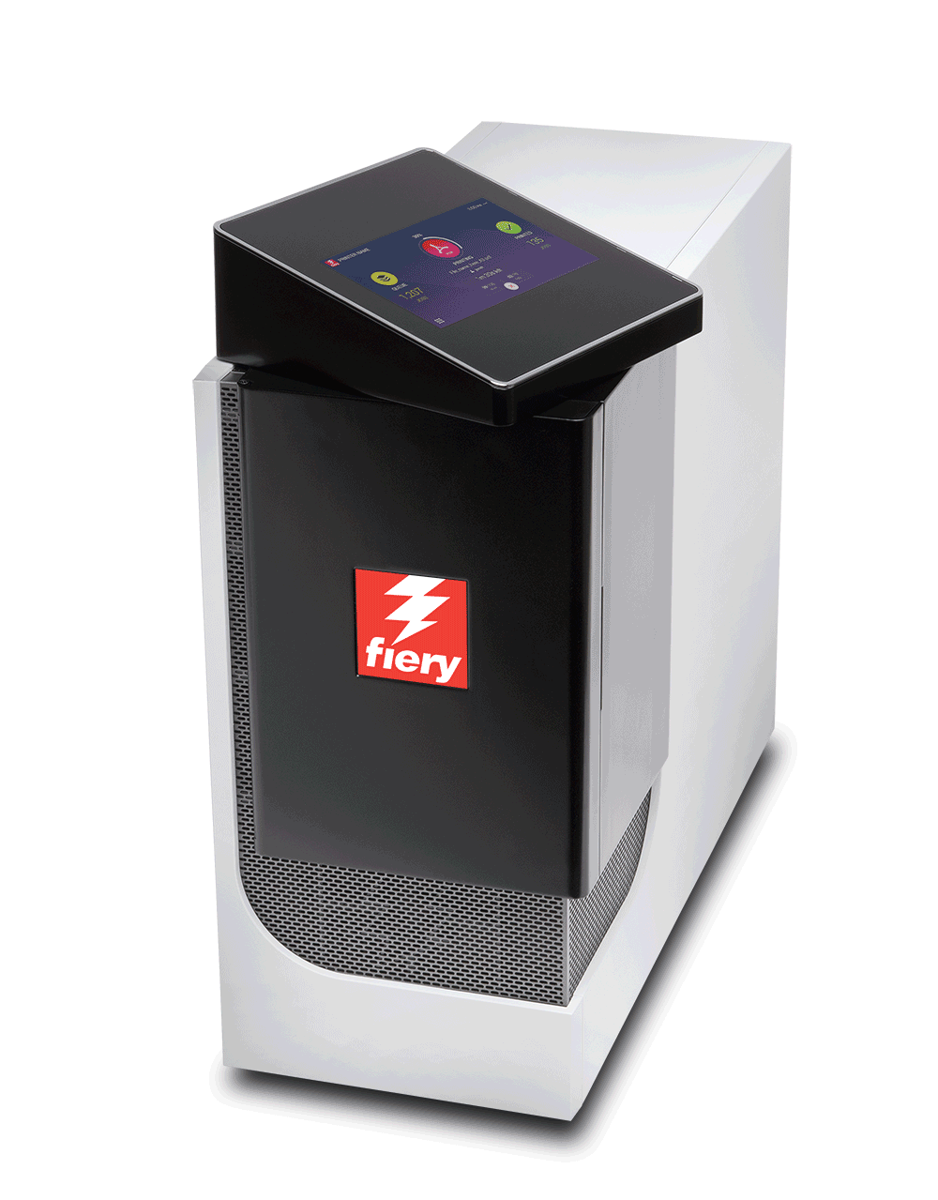
新型 Fiery NX Premium 和 NX Pro
新型 NX 服务器工业设计
带 Fiery QuickTouch 软件的新型触摸 屏显示面板
通过全新 NX Station 实现高效运营
访问 Fiery 产品解决方案网页
旋转触摸屏面板
Notes:
FS300 Pro servers feature the cutting-edge and innovative Fiery NX industrial design that was precisely crafted with the Fiery operator in mind.
The Fiery NX Premium is the high-end Fiery DFE that replaces the Fiery QX100 servers. The Fiery NX Pro is the server that replaces the Fiery Pro 80 hardware platforms.
The new server design includes the Fiery QuickTouch interface that helps users speed up job and device management. The touchscreen display rotates and provides intuitive system installation, backup, and diagnosis; plus easy access to and faster views of job status information. It also includes 3 USB ports, conveniently located on the side of the display
Either the Fiery NX server (Premium or Pro) can be placed inside the new Fiery NX Station to provide a centralised work station that adapts to different print production environments. The work stations come in two versions: The NX Station GL is the basic configuration, and the NX Station LS adds an adjustable-height workspace, a larger monitor, a proximity sensor that wakes up the Fiery server as soon as it identifies someone approaching, and tidy power cable storage.

Slide 14
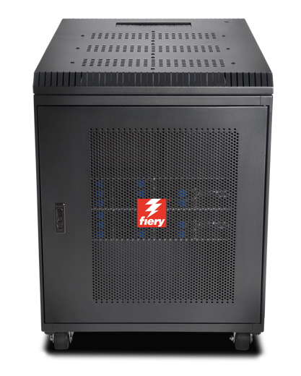
Fiery XB
旨在广泛用于各个市场
包装 折叠纸盒、瓦楞纸箱和灵活的包装方式
商务印刷
交易/IPDS，直邮
高性能、叶片式架构
最大 1.8 米 x 3 米纸张，或 1 米宽卷材
高达 15000 SPH（B1，1200x1200 dpi）
高达 200 mpm 轧辊进给 (1m 1200x1200 dpi)
Notes:
The Fiery XB hardware platform is designed for a wide variety of high-production markets such as packaging, commercial print, and transactional.
Its high-performance, bladed architecture fulfills demands for high throughput and a wide range of paper widths.

Slide 15
Fiery FS300 Pro 系统软件
打印业务的竞争力依赖于无与伦比的生产效率、颜色质量和集成性
Notes:
This section covers the new features in the Fiery system software — Fiery FS300 Pro

Slide 16
FS300 Pro 亮点
输出质量控制
性能
安全性
可维修性
集成性
Notes:
The new features target the areas users care most about:
Output quality control
Performance
Security
Serviceability
Integration

Slide 17
输出质量控制
Fiery Spot-On™
专色群组优先级
Fiery ImageViewer
对象检查器
总区域覆盖
Notes:
There are several new features that offer new tools to enhance output quality control, and are great additions for professional prepress environments:
The Fiery Spot-On feature adds spot colour group priority
Fiery ImageViewer, part of Fiery Graphic Arts, Premium Edition and Fiery Productivity Package, adds object inspector and total area coverage features

Slide 18
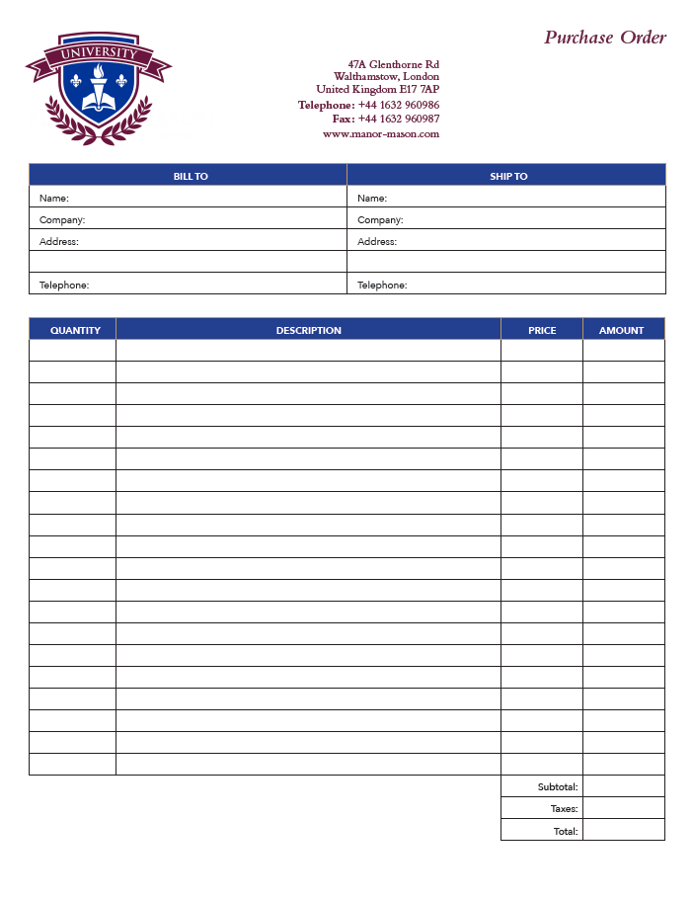
专色群组优先级
轻松满足自定义颜色 预置
按作业定义颜色库顺序
节省了在“设备中心”中对颜色群组重新排序的时间
需要 Fiery Spot-On
Notes:
Spot colour group priority is a feature that enables users to easily ensure that custom spot colour representation is honored to satisfy print buyer’s expectations.
This is a very useful feature for print environments where Fiery users edit the appearance of specific spot colours to match the expectations of print buyers. These spot colour edits are saved as new groups of colours using the Spot-On interface in Device Center.
But sometimes different print buyers want different edits to the same spot colours, or one buyer may request an adjustment — but other print buyers like the default colour mapping of the spot colour.
The spot colour group priority feature allows the Fiery user to set which of the colour libraries in Spot-On takes priority for a given job from the Color tab in Job Properties or Fiery driver. This means that if the requested spot colour adjustment for one customer is created in a custom spot colour library, the library can be given priority when printing that customer's jobs without forcing the spot colour edit for all future print jobs.
This feature can save a lot of time for users who no longer need to constantly check on the order of the colour libraries or groups in Spot-On.

Slide 19
对象检查器
显示光栅像素的对象类型
文本、图形、图像、平滑阴影和边缘
通过基于对象的设定帮助识别问题：
仅使用黑色打印灰色
边缘增强效果
例如，Dynamic HD Text and Graphics
基于对象的光栅
缩短故障排除时间
需要 Fiery Graphic Arts Package, Premium Edition 或 Fiery Productivity Package
Notes:
Object Inspector, part of Fiery ImageViewer 3.0, helps identify imaging problems related to specific object types. The tool identifies what type of page object was in the original page description file before it was RIPped. It can identify object types including image, graphic, smooth shade, text, and edge.
The feature allows the user to troubleshoot image quality issues related to page object type more efficiently. Some examples include the ability to:
Identify a page object that may fail to use black only because gray settings in Job Properties are not set to use black only for that object type.
Identify cases where a colour mismatch within a page is related to how each object type is processed, such as halftone screen. These colour mismatches are hard to identify since the colour looks identical in the raster, but they print with a mismatch when they are screened on the print engine.
Determine where pixels are being tagged for edge enhancement by features such as Fiery Dynamic HD Text and Graphics or engine-specific edge-enhancement technologies.

Slide 20
总区域覆盖
显示分色值之和
有助于识别达到总区域覆盖限制的区域
可用于解决诸如缺少阴影细节的成像问题
需要 Fiery Graphic Arts Package, Premium Edition 或 Fiery Productivity Package
Notes:
Total Area Coverage, also part of Fiery ImageViewer 3.0, reports the sum of colour separation values for a pixel. This can help users troubleshoot image quality issues related to toner or ink coverage, and determine whether the toner or ink limit has been reached.

Slide 21
灰度输入特性档
达到灰度图像、矢量或图形对象的预期打印效果
以与 RGB 和 CMYK 相同的方式指定颜色渲染控制
“作业属性”和驱动程序中“颜色”选项卡中的“灰度”设定
Notes:
Previous Fiery servers render grayscale objects using the CMYK source profile, which can result in an unexpected and often incorrect appearance.
This feature provides users with specific control over the colour management of grayscale page objects by adding grayscale settings in the Color tab in Job Properties and the driver.
When grayscale page objects are created in a design application such as Adobe Photoshop, a grayscale ICC profile is used to define their intended appearance. This feature lets the user set the same profile to be used on the Fiery server so that the expected appearance can be maintained when printing.

Slide 22
性能增强
HyperRIP 优化
快速重新打印
新一代硬件
NX Pro 和 Premium 服务器
XB 服务器
观看 HyperRIP 视频
处理作业的速度提升 55%
Notes:
Fiery FS300 Pro servers process jobs faster with innovative technology:
Fiery NX Premium servers include Fiery HyperRIP, which can process more file formats in this mode
All Fiery FS300 Pro servers include fast reprint from Command WorkStation 6: This features enables jobs in the PRINTED queue to start printing the instant they are sent to print again
Fiery FS300 Pro servers ship with new hardware platforms which deliver faster processing performance

Slide 23
单个作业模式下支持的文件格式
文件类型 | 普通纸 | 双面 | XObjects / 形式缓存 | 混合纸张 | 控制栏 | 打印范围 页/记录 | 拼版 | Post-flight | 直接队列
CPSI 工作流程
PDF | 是 | 是 | 是 | 是 | 是 | 是 | 否 | 否 | 是
PS | 是 | 是 | 是 | 是 | 是 | 是 | 否 | 否 | 否
QuickDoc Merge | 是 | 是 | 是 | 是 | 是 | 是 | 否 | 否 | 否
PDF/VT | 是 | 是 | 是 | 是 | 是 | 是 | 否 | 否 | 是
PPML | 是 | 是 | 是 | 是 | 是 | 是 | 否 | 否 | 否
VPS | 是 | 是 | 是 | 是 | 是 | 是 | 否 | 否 | 否
VIPP | 是 | 是 | 是 | 是 | 是 | 是 | 否 | 否 | 否
FreeForm 主文页 | 否 | 否 | 否 | 否 | 否 | 否 | 否 | 否 | 否
FreeForm 可变 | 是 | 是 | 是 | 是 | 是 | 是
TIF | 否 | 否 | 否 | 否 | 否 | 否 | 否 | 否 | 否
EPS | 否 | 否 | 否 | 否 | 否 | 否 | 否 | 否 | 否
APPE 工作流程
PDF | 是 | 是 | 是 | 是 | 是 | 是 | 否 | 否 | 是
PDF/VT | 是 | 是 | 是 | 是 | 是 | 是 | 否 | 否 | 是
PCL 工作流程
PCL | 否 | 否 | 否 | 否 | 否 | 否 | 否 | 否 | 否
否
FS200 Pro 表
FS300 Pro 表
Notes:
This slide shows the file formats not supported by HyperRIP before FS300 Pro in single-job mode.

Slide 24
单个作业模式下支持的文件格式
文件类型 | 普通纸 | 双面 | XObjects / 形式缓存 | 混合纸张 | 控制栏 | 打印范围 页/记录 | 拼版 | Post-flight | 直接队列
CPSI 工作流程
PDF | 是 | 是 | 是 | 是 | 是 | 是 | 否 | 否 | 是
PS | 是 | 是 | 是 | 是 | 是 | 是 | 否 | 否 | 否
QuickDoc Merge | 是 | 是 | 是 | 是 | 是 | 是 | 否 | 否 | 否
PDF/VT | 是 | 是 | 是 | 是 | 是 | 是 | 否 | 否 | 是
PPML | 是 | 是 | 是 | 是 | 是 | 是 | 否 | 否 | 否
VPS | 是 | 是 | 是 | 是 | 是 | 是 | 否 | 否 | 否
VIPP | 是 | 是 | 是 | 是 | 是 | 是 | 否 | 否 | 否
FreeForm 主文页 | 否 | 否 | 否 | 否 | 否 | 否 | 否 | 否 | 否
FreeForm 可变 | 是 | 是 | 是 | 是 | 是 | 是
TIF | 否 | 否 | 否 | 否 | 否 | 否 | 否 | 否 | 否
EPS | 否 | 否 | 否 | 否 | 否 | 否 | 否 | 否 | 否
APPE 工作流程
PDF | 是 | 是 | 是 | 是 | 是 | 是 | 否 | 否 | 是
PDF/VT | 是 | 是 | 是 | 是 | 是 | 是 | 否 | 否 | 是
PCL 工作流程
PCL | 否 | 否 | 否 | 否 | 否 | 否 | 否 | 否 | 否
FS300 Pro 表
Notes:
As you can see, FS300 Pro supports many more formats in single-job mode.

Slide 25
安全性增强
Windows 10 IoT Enterprise
利用 Windows Defender SmartScreen 实现防恶意应用程序保护
通过 SMB 加固和企业证书锁定实现中间人保护
通过 Windows Defender 和 Windows 数据执行保护实现防恶意软件和防病毒保护
Notes:
Fiery external servers ship with the Microsoft Windows 10 IoT Enterprise 2016 LTSB edition (Windows 10) operating system, which contains the latest security protections. These key features address security protections. See the Fiery FS300 Pro Security white paper for more information.
Enable Windows Defender SmartScreen feature to prevent malicious applications from being downloaded. This additional security feature may affect Fiery server performance and is not turned on by default.
Windows 10 comes with SMB hardening for SYSVOL and NETLOGON shares, which helps mitigate man-in-the-middle attacks for Fiery servers joined to a domain.
Windows Defender Antivirus helps keep devices free of viruses and other malware. Fiery server is configured with the feature turned on to scan c:\, but not e:\ to minimise performance impact. Administrators can configure Windows Defender to scan e:\ if desired.
Windows Data Execution Prevention (DEP) can be enabled for Windows programs and services to help prevent malware from using the memory manipulation technique.
Windows 10 has better memory protections for heap and kernel pools to help prevent exploitation of memory.
Enterprise certificate pinning helps prevent man-in-the-middle attacks. This is an enterprise feature. A Fiery server has to join a domain to enable the feature.

Slide 26
可维修性改进
最大程度减少生产中断
Fiery 更新
轻松保持 Fiery 服务器最新
自动系统备份
还原后快速恢复
Notes:
Serviceability improvements in Fiery FS300 Pro offer administrators, analysts, and technicians better ways to ensure that Fiery servers are always up to date, minimise downtime, and provide fast recovery of Fiery servers.
Fiery Updates is a new feature introduced with Command WorkStation 6. Because timely software updates are critical for optimal operation of Fiery servers, Command WorkStation offers administrators an easy way to get notifications, downloads, and installation of approved and released Fiery system updates.
Administrators access Fiery Updates through the Device Center and can perform updates, even from remote client computers. This way, they can still update even Fiery servers that may not be connected to the internet. At the Fiery Updates screen, administrators can also see all the patches and service packs available and waiting to be installed for external or embedded servers.
Fiery Updates ensures the right sequence of patch updates to guarantee effective installation and avoid incompatibilities.

Slide 27
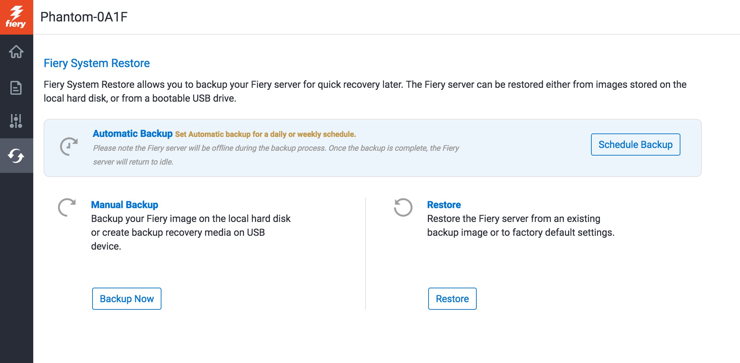
自动系统备份
通过 Fiery QuickTouch 和 WebTools 建立备份计划
不到一个小时即可还原 Fiery 服务器
所需时间仅为通过 DVD 套件加载的 1/8
无需 DVD 套件
Notes:
Fiery administrators now have an easy way to schedule automatic Fiery system backups to guarantee fast recovery — and without the need to restore from a DVD media kit.
They can manage backups using Fiery WebTools or the Fiery QuickTouch interface. With these tools, it can take less than an hour to restore from a backup — 1/8th of the time it takes to restore from a DVD kit.

Slide 28
集成增强
新 API 和更高的可用性，可轻松集成 Fiery API v4 中的内部应用程序
支持 JDF 的新 Fiery 采用 Fiery JDF v1.5
EFI AutoCount
EFI Quick Print Suite
Kodak Prinergy 8.1
Notes:
Fiery API and Fiery JDF are always improving to bring usability enhancements and tighter integration with EFI web-to-print and MIS systems plus third-party prepress workflow solutions.

Slide 29
Fiery FS300 Pro 的价值
在客户的重要领域引领创新
驱动行业最先进的数字印刷机的诞生
Notes:
Fiery servers bring innovation to areas important to customers and continue the evolution of printing by driving the most advanced digital presses.

Slide 30
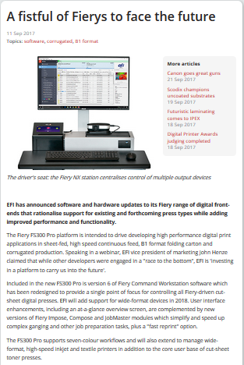
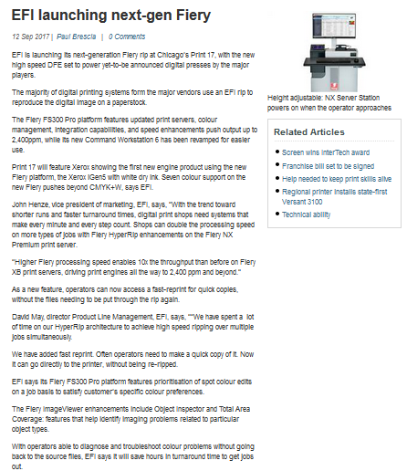
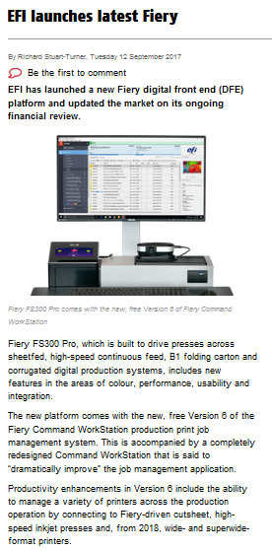
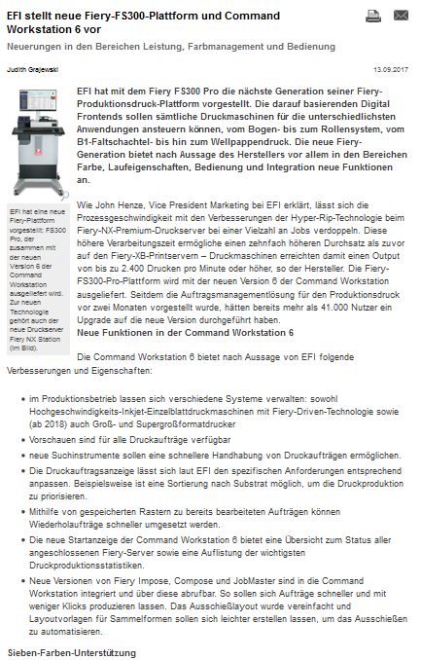
公开发布
EFI 新闻发布：
欧洲和美国：9 月 11 日
EFI 新闻发布
新闻稿
他们在思考什么
每日印刷展
Deutscher Drucker
PrintWeek
澳大利亚打印机
数字打印机
Notes:
This slide gives you links for direct access to the EFI press release posted in September 2017, and to the various press articles all around the globe.

