Slide 1
Fiery FS300 Pro
新功能指南
簡報者姓名
職稱
Notes:
This presentation will give you a closer look into what’s new in this new platform and offers the marketing positioning and overall message for the launch of Fiery FS300 Pro.

Slide 2
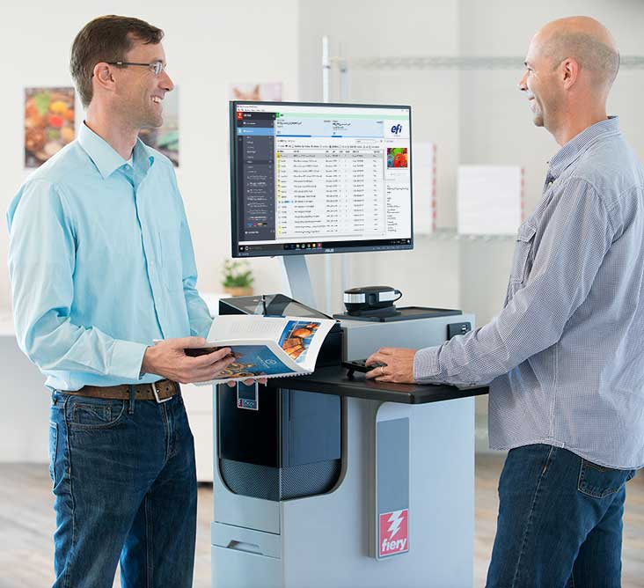
何謂 Fiery FS300 Pro 平台？
「新世代平台」
  為使用者量身設計
    使用者在 Fiery® 的每一操作皆能感受創新。
    使用者關切的關鍵領域新功能：色彩、生產力、易用性及整合
  驅動 Fiery Driven™ 印刷機
    單頁紙、高速連續進紙、B1 摺疊紙盒和瓦楞紙
Notes:
Let’s first answer “What is the Fiery FS300 Pro”? And what does FS300 Pro mean for users?
First of all, Fiery FS300 Pro is not just system software, it is a platform. It’s a platform that converges all aspects of a digital front end, or DFE, solution. Fiery DFEs include hardware, software, workflow solutions, and more.
FS300 Pro platform defines and sets the direction for Fiery servers in the next decade by:
Focusing on users with a redesign and innovation in almost every single touch point the user has with Fiery. This includes everything from exterior design that incorporates a Fiery QuickTouch display to interact with the Fiery server, to the furniture stand, and all aspects of user interface in Command WorkStation.
And, of course, FS300 Pro adds new features in the key areas users care about: colour, productivity, usability, and integration.
In addition to that, FS300 Pro drives multiple print technologies, not only cutsheet toner presses. With ever-increasing demands for faster thoughput in production printing, Fiery is now driving very high-speed presses such as the Xerox Trivor 2400, Landa’s Nanographic presses, our own Nozomi for corrugated, and many other engines.

Slide 3
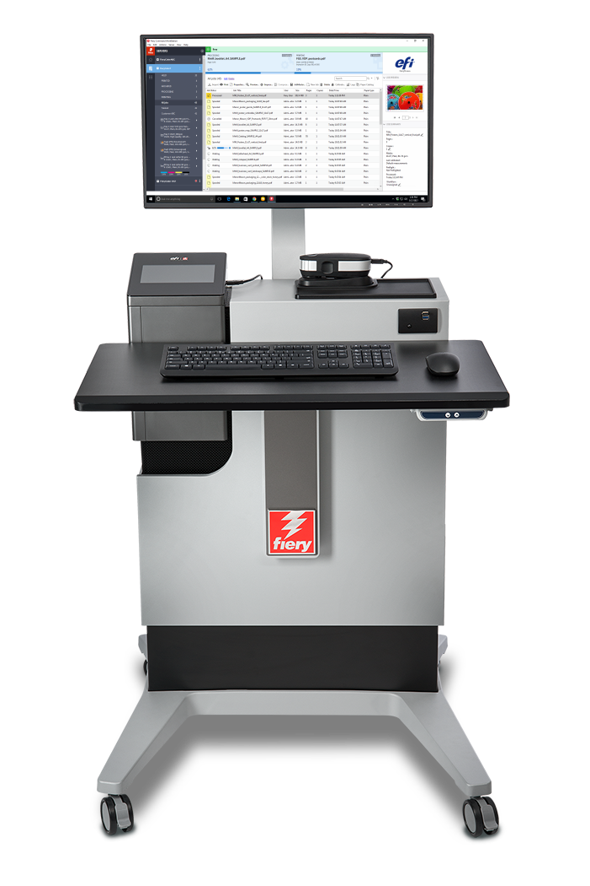
全新的平台創新
Fiery FS300 Pro 系統軟體
Fiery Command WorkStation®
Fiery NX 和 XB 平台
Fiery 排版調整工作流程
Notes:
As you can see in this slide, all the latest innovations ship with this new Fiery DFE platform.
A new user interface, with Command WorkStation 6
A new industrial design and hardware specs for Fiery NX and Fiery XB servers
A new codebase with FS300 Pro system software
And major enhancements to Fiery makeready solutions

Slide 4




Fiery FS300 Pro 新功能
  支援 7 種色彩
  特別色群組優先順序
  灰階輸入設定檔
  Fiery ImageViewer
  物件檢查
  總區域用量
新硬體
APPE 4*
HyperRIP 增強功能
迅速重新列印
Fiery Impose：
多聯拼版自動化增強功能
  自動旋轉頁面
  標記預設值
  Fiery Command WorkStation 6
    預覽所有工作
    自動移除點陣
  Fiery NX 設計
    Fiery QuickTouch
    Fiery NX Station
Fiery JobMaster：
影像戳記
匯入掃描頁面
頁面位移
其他排版調整增強功能
  Windows 10
  安全性增強功能
  自動系統備份
  從 Command WorkStation 進行 Fiery 更新
  802.1x EAP-TLS
  自動設定 Proxy 組態
  整合增強功能
* 持續更新 APPE 增強功能與服務版本。
Notes:
Another way to see what’s new in FS300 Pro across print technologies, is to look at areas users care about the most.
As you can see, all areas are represented with new features to reinforce Fiery leadership in the print industry.
Let’s examine these new features in the following slides.

Slide 5

Fiery Command WorkStation 6
適用於 Fiery 伺服器的最直覺式列印工作管理介面
Notes:
Let’s start first with Command WorkStation 6 — the new user interface for print job management for Fiery DFEs.

Slide 6

Fiery Command WorkStation 6
管理列印工作更快速、提高列印生產量
更加直覺且易於使用
提升效率與生產力
為經理提供的新工具
升級程序順暢又快速
因應未來
存取完整簡報
Notes:
Version 6 offers better usability and higher efficiency. And all you have to do to get these benefits is to download it for free from efi.com/cws.
In addition to operator benefits, there are also new tools for production managers.
Version 6 works with Fiery servers running Fiery System 10 and above, and also provides future connectivity to Fiery servers driving wide- and superwide-format printers.

Slide 7
版本 6 的新功能
可從版本 5 輕鬆轉換
升級程序順暢又快速
歡迎導覽
更加直覺且易於使用
使用者介面新穎且簡潔
提升效率與生產力
適用於所有工作的工作預覽*
自動移除點陣*
迅速重新列印*
工作搜尋功能
  簡易搜尋
  進階搜尋
  自訂檢視和篩選器
工作屬性中的色彩設定
設定預設值
  色彩管理預設值
內置編輯
為生產經理提供的新工具
首頁檢視
  伺服器狀態
  生產指標速覽
Fiery 更新
設定預設值
*僅 FS300 Pro 伺服器提供的新功能
Notes:
The list of new features has some that were specifically designed to work with FS300 Pro servers or later.
Job preview for all jobs works only on external Fiery servers running Fiery FS300 Pro
Automatically remove rasters and fast reprint is supported by both, external and embedded servers running Fiery FS300 Pro/FS300.

Slide 8
排版調整解決方案的新功能
Fiery Impose Fiery Compose Fiery JobMaster | 易用性增強功能 更容易設定喜好設定、維持視窗與窗格尺寸、顯示底材色彩、增強頁面插入功能、工作儲存速度更快、更快速選擇紙張尺寸 Acrobat DC Professional 和 PitStop Edit 13
Fiery Impose | 依底材尺寸自動多聯拼版 自動旋轉頁面 標記預設值 VDP 手冊封面可採混合底材 日本剪切裁線工作流程自動化 30 天免費試用
Fiery JobMaster | 影像戳記 匯入掃描頁面 頁面位移 30 天免費試用
*僅 FS300 Pro 伺服器提供的新功能
存取完整簡報
Notes:
In the list of makeready new features, there is also one feature that is specific to FS300/FS300 Pro servers (embedded or external) — the ability to save Impose templates containing Japanese crop marks. This allows users to automate job layout preparation using this type of crop mark.

Slide 9
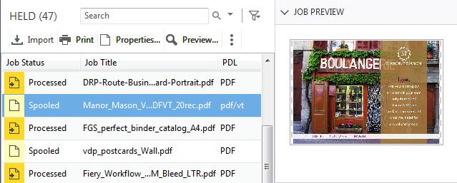
適用於所有工作的工作預覽
更快識別工作
  效能不受影響
  僅能預覽第一頁
  支援的檔案格式：
    PS、PDF、PDF/VT、TIF、EPS
  僅適用於外部 Fiery 伺服器
Notes:
Users with external Fiery servers running FS300 Pro and Windows 10 can now preview all jobs. This helps operators identify and find jobs faster.
Previewing jobs doesn’t impact the Fiery server performance, so the feature is always on. The preview lets operators see the first page of the job.
While the feature doesn’t work with PPML files, it does work with PostScript, PDF, PDF/VT, TIF, and EPS files.

Slide 10
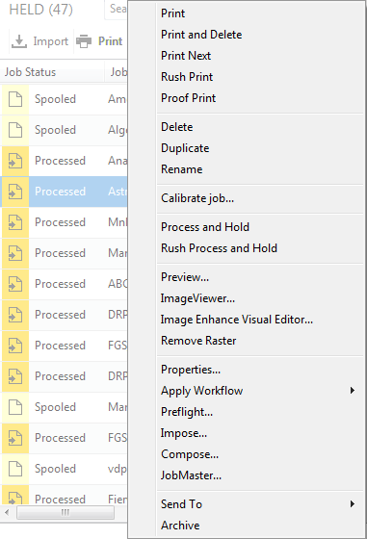
自動移除點陣
按一下即可存取排版調整設定
已處理工作與多工緩衝處理工作具有相同工作動作
Notes:
The next feature is called “automatically remove rasters.”
With this feature, users who want to resume the job layout and makeready settings after processing a job, will no longer need to select “Remove Raster” before accessing Impose, Compose, or JobMaster. The Fiery server will “Remove Raster” automatically if any of those makeready options are selected from the Actions menu.
This shortens access to makeready settings from three clicks to one, and offers a more intuitive experience since users will see job actions for processed jobs that are consistent with those for spooled jobs.

Slide 11
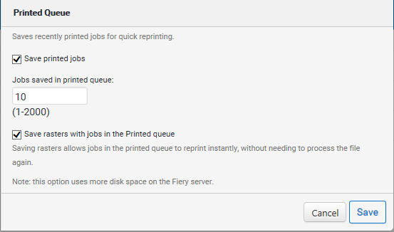
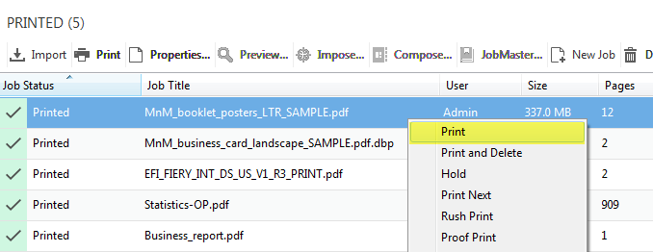
迅速重新列印
重新列印工作，無須再次進行點陣影像處理
使用 Configure 中的新選項來儲存點陣資料檔案和已列印佇列中的工作
在 Configure 中啟用「儲存點陣資料和已列印佇列中的工作」
Notes:
Fast Reprint can save a lot of time.
Using this feature, administrators can keep the raster files for jobs in the PRINTED queue. When the print service provider needs to reprint those jobs, the files start printing the instant jobs are sent to print, without re-RIPping.
This feature is on by default and can be disabled from the Configure menu, as the screenshot on the right shows.
This is a great feature when users need to print one copy of a job as a proof, and then print it again for production. All they have to do is just change the copy count.

Slide 12
Fiery NX 和 XB 平台

Slide 13
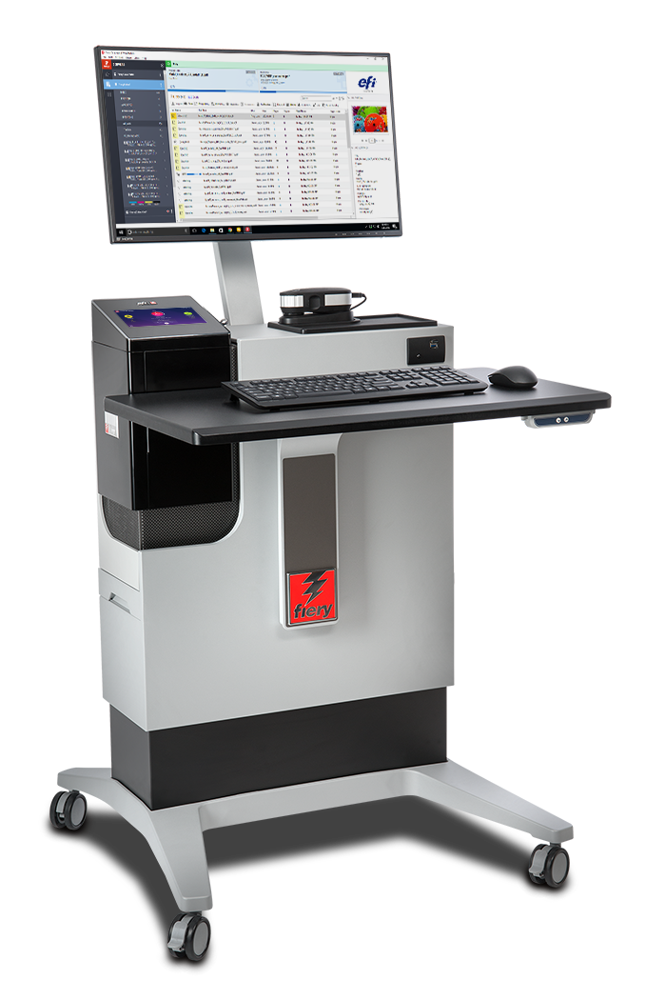
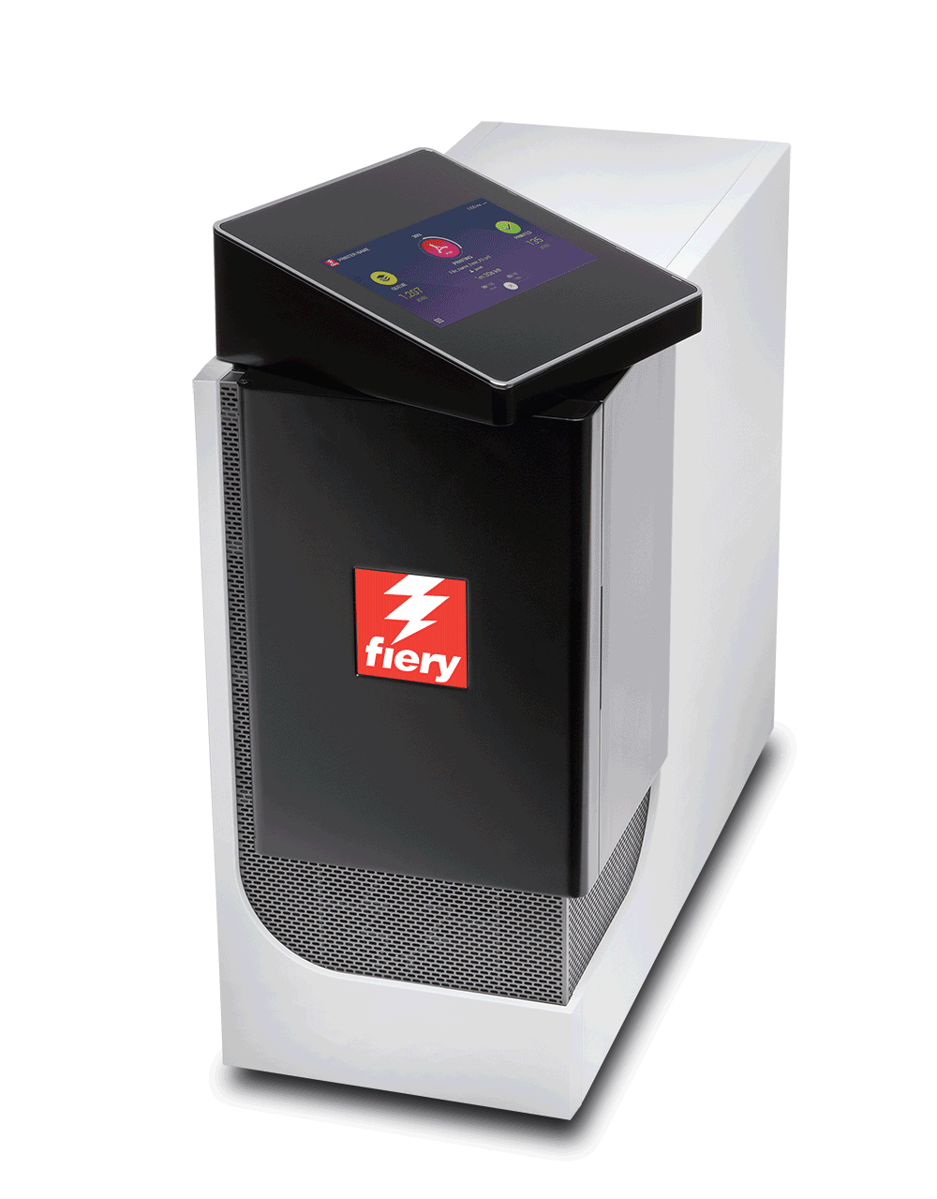
全新的 Fiery NX Premium 與 NX Pro
全新的 NX 伺服器工業設計
全新的觸控螢幕顯示器面板搭配 Fiery QuickTouch 軟體
全新 NX Station 操作效率高
存取 Fiery 生產解決方案網頁
旋轉觸控螢幕面板
Notes:
FS300 Pro servers feature the cutting-edge and innovative Fiery NX industrial design that was precisely crafted with the Fiery operator in mind.
The Fiery NX Premium is the high-end Fiery DFE that replaces the Fiery QX100 servers. The Fiery NX Pro is the server that replaces the Fiery Pro 80 hardware platforms.
The new server design includes the Fiery QuickTouch interface that helps users speed up job and device management. The touchscreen display rotates and provides intuitive system installation, backup, and diagnosis; plus easy access to and faster views of job status information. It also includes 3 USB ports, conveniently located on the side of the display
Either the Fiery NX server (Premium or Pro) can be placed inside the new Fiery NX Station to provide a centralised work station that adapts to different print production environments. The work stations come in two versions: The NX Station GL is the basic configuration, and the NX Station LS adds an adjustable-height workspace, a larger monitor, a proximity sensor that wakes up the Fiery server as soon as it identifies someone approaching, and tidy power cable storage.

Slide 14
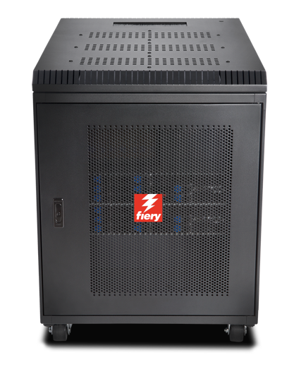
Fiery XB
專為廣大市場設計
  包裝
  摺疊紙盒、瓦楞紙且包裝靈活
  商業列印
  交易/IPDS，直接郵件
高效能、刀鋒式架構
  最多 1.8 公尺 x 3 公尺紙張，或 1 公尺寬網頁
  最多 15000 SPH (B1, 1200x1200 dpi)
  最多 200 mpm 捲筒進紙 (1 公尺 1200x1200 dpi)
Notes:
The Fiery XB hardware platform is designed for a wide variety of high-production markets such as packaging, commercial print, and transactional.
Its high-performance, bladed architecture fulfills demands for high throughput and a wide range of paper widths.

Slide 15
Fiery FS300 Pro 系統軟體
無可比擬的生產力、色彩品質和整合能力，維持列印業務的競爭力。
Notes:
This section covers the new features in the Fiery system software — Fiery FS300 Pro

Slide 16
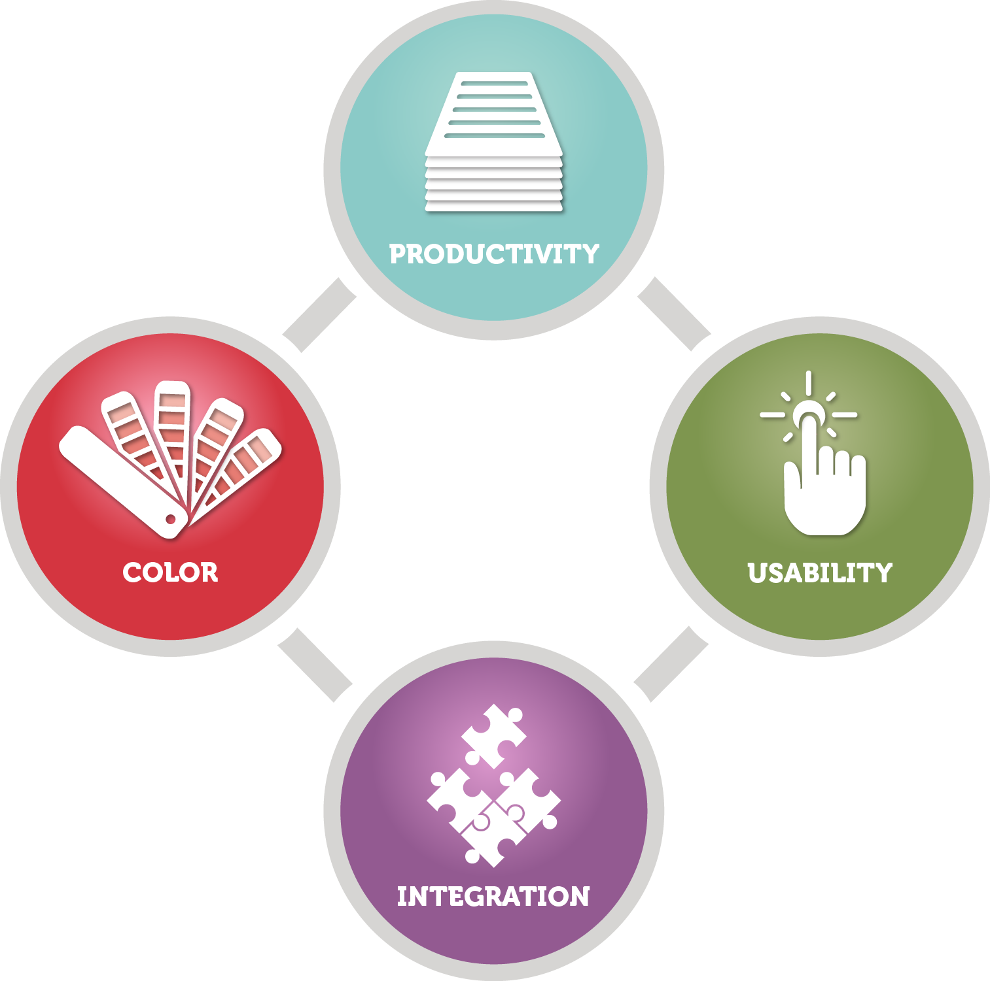

FS300 Pro 著重領域
輸出品質控制
效能
安全性
服務性
整合
Notes:
The new features target the areas users care most about:
Output quality control
Performance
Security
Serviceability
Integration

Slide 17

輸出品質控制
Fiery Spot-On™
  特別色群組優先順序
Fiery ImageViewer
  物件檢查
  總區域用量
Notes:
There are several new features that offer new tools to enhance output quality control, and are great additions for professional prepress environments:
The Fiery Spot-On feature adds spot colour group priority
Fiery ImageViewer, part of Fiery Graphic Arts, Premium Edition and Fiery Productivity Package, adds object inspector and total area coverage features

Slide 18


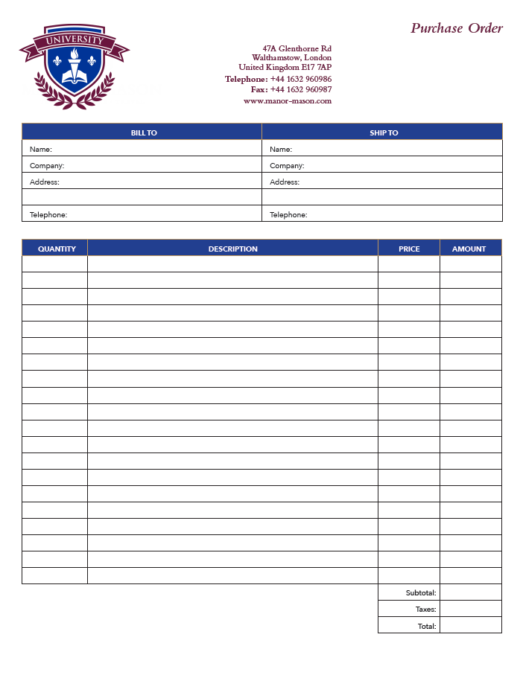

特別色群組優先順序
輕鬆滿足自訂色彩喜好設定
按工作定義色彩庫順序
節省在裝置中心重新排列色彩群組的時間
需要 Fiery Spot-On
Notes:
Spot colour group priority is a feature that enables users to easily ensure that custom spot colour representation is honored to satisfy print buyer’s expectations.
This is a very useful feature for print environments where Fiery users edit the appearance of specific spot colours to match the expectations of print buyers. These spot colour edits are saved as new groups of colours using the Spot-On interface in Device Center.
But sometimes different print buyers want different edits to the same spot colours, or one buyer may request an adjustment — but other print buyers like the default colour mapping of the spot colour.
The spot colour group priority feature allows the Fiery user to set which of the colour libraries in Spot-On takes priority for a given job from the Color tab in Job Properties or Fiery driver. This means that if the requested spot colour adjustment for one customer is created in a custom spot colour library, the library can be given priority when printing that customer's jobs without forcing the spot colour edit for all future print jobs.
This feature can save a lot of time for users who no longer need to constantly check on the order of the colour libraries or groups in Spot-On.

Slide 19
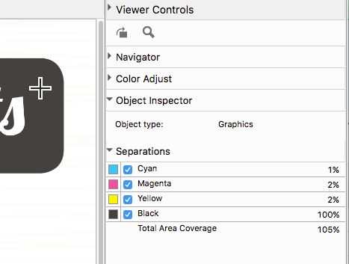
物件檢查
顯示點陣像素的物件類別
  文字、圖形、影像、平滑陰影和邊緣
幫助識別物件為主的設定問題：
  僅使用黑色來列印灰色
  邊緣增強效果
    例如，動態 HD 文字和圖形
  物件為主的點陣
減少移難排解的時間
需要 Fiery Graphic Arts Package, Premium Edition 或 Fiery Productivity Package
Notes:
Object Inspector, part of Fiery ImageViewer 3.0, helps identify imaging problems related to specific object types. The tool identifies what type of page object was in the original page description file before it was RIPped. It can identify object types including image, graphic, smooth shade, text, and edge.
The feature allows the user to troubleshoot image quality issues related to page object type more efficiently. Some examples include the ability to:
Identify a page object that may fail to use black only because gray settings in Job Properties are not set to use black only for that object type.
Identify cases where a colour mismatch within a page is related to how each object type is processed, such as halftone screen. These colour mismatches are hard to identify since the colour looks identical in the raster, but they print with a mismatch when they are screened on the print engine.
Determine where pixels are being tagged for edge enhancement by features such as Fiery Dynamic HD Text and Graphics or engine-specific edge-enhancement technologies.

Slide 20

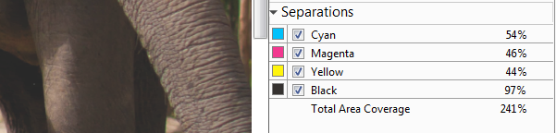
總區域用量
顯示分色值的總和
幫助識別達到總區域用量限制的區域
可用於排除如缺乏陰影細節的影像問題
需要 Fiery Graphic Arts Package, Premium Edition 或 Fiery Productivity Package
Notes:
Total Area Coverage, also part of Fiery ImageViewer 3.0, reports the sum of colour separation values for a pixel. This can help users troubleshoot image quality issues related to toner or ink coverage, and determine whether the toner or ink limit has been reached.

Slide 21
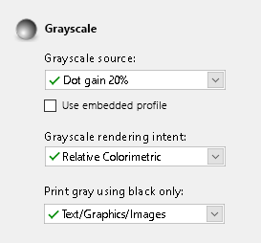
灰階輸入設定檔
符合預期灰階影像、向量或圖形物件的列印外觀
指定與 RGB 和 CMYK 相同的色彩對應控制
「工作屬性」和驅動程式中「色彩」索引標籤的「灰階」設定
Notes:
Previous Fiery servers render grayscale objects using the CMYK source profile, which can result in an unexpected and often incorrect appearance.
This feature provides users with specific control over the colour management of grayscale page objects by adding grayscale settings in the Color tab in Job Properties and the driver.
When grayscale page objects are created in a design application such as Adobe Photoshop, a grayscale ICC profile is used to define their intended appearance. This feature lets the user set the same profile to be used on the Fiery server so that the expected appearance can be maintained when printing.

Slide 22

效能增強功能
HyperRIP 最佳化
迅速重新列印
新一代硬體
  NX Pro 和 Premium 伺服器
  XB 伺服器
觀看 HyperRIP 影片
處理工作的速度提升 55%
Notes:
Fiery FS300 Pro servers process jobs faster with innovative technology:
Fiery NX Premium servers include Fiery HyperRIP, which can process more file formats in this mode
All Fiery FS300 Pro servers include fast reprint from Command WorkStation 6: This features enables jobs in the PRINTED queue to start printing the instant they are sent to print again
Fiery FS300 Pro servers ship with new hardware platforms which deliver faster processing performance

Slide 23
單一工作模式下支援的檔案格式
檔案類型 | 普通 | 雙面 | XObjects / Form Caching | 混合底材 | 控制列 | 列印範圍 頁/記錄 | 拼版 | Post-flight | 直接佇列
CPSI 工作流程
PDF | 是 | 是 | 是 | 是 | 是 | 是 | 否 | 否 | 是
PS | 是 | 是 | 是 | 是 | 是 | 是 | 否 | 否 | 否
QuickDoc Merge | 是 | 是 | 是 | 是 | 是 | 是 | 否 | 否 | 否
PDF/VT | 是 | 是 | 是 | 是 | 是 | 是 | 否 | 否 | 是
PPML | 是 | 是 | 是 | 是 | 是 | 是 | 否 | 否 | 否
VPS | 是 | 是 | 是 | 是 | 是 | 是 | 否 | 否 | 否
VIPP | 是 | 是 | 是 | 是 | 是 | 是 | 否 | 否 | 否
FreeForm 主文件 | 否 | 否 | 否 | 否 | 否 | 否 | 否 | 否 | 否
FreeForm 可變 | 是 | 是 | 是 | 是 | 是 | 是
TIF | 否 | 否 | 否 | 否 | 否 | 否 | 否 | 否 | 否
EPS | 否 | 否 | 否 | 否 | 否 | 否 | 否 | 否 | 否
APPE 工作流程
PDF | 是 | 是 | 是 | 是 | 是 | 是 | 否 | 否 | 是
PDF/VT | 是 | 是 | 是 | 是 | 是 | 是 | 否 | 否 | 是
PCL 工作流程
PCL | 否 | 否 | 否 | 否 | 否 | 否 | 否 | 否 | 否
否
FS200 Pro 表
FS300 Pro 表
Notes:
This slide shows the file formats not supported by HyperRIP before FS300 Pro in single-job mode.

Slide 24
單一工作模式下支援的檔案格式
檔案類型 | 普通 | 雙面 | XObjects / Form Caching | 混合底材 | 控制列 | 列印範圍 頁/記錄 | 拼版 | Post-flight | 直接佇列
CPSI 工作流程
PDF | 是 | 是 | 是 | 是 | 是 | 是 | 否 | 否 | 是
PS | 是 | 是 | 是 | 是 | 是 | 是 | 否 | 否 | 否
QuickDoc Merge | 是 | 是 | 是 | 是 | 是 | 是 | 否 | 否 | 否
PDF/VT | 是 | 是 | 是 | 是 | 是 | 是 | 否 | 否 | 是
PPML | 是 | 是 | 是 | 是 | 是 | 是 | 否 | 否 | 否
VPS | 是 | 是 | 是 | 是 | 是 | 是 | 否 | 否 | 否
VIPP | 是 | 是 | 是 | 是 | 是 | 是 | 否 | 否 | 否
FreeForm 主文件 | 否 | 否 | 否 | 否 | 否 | 否 | 否 | 否 | 否
FreeForm 可變 | 是 | 是 | 是 | 是 | 是 | 是
TIF | 否 | 否 | 否 | 否 | 否 | 否 | 否 | 否 | 否
EPS | 否 | 否 | 否 | 否 | 否 | 否 | 否 | 否 | 否
APPE 工作流程
PDF | 是 | 是 | 是 | 是 | 是 | 是 | 否 | 否 | 是
PDF/VT | 是 | 是 | 是 | 是 | 是 | 是 | 否 | 否 | 是
PCL 工作流程
PCL | 否 | 否 | 否 | 否 | 否 | 否 | 否 | 否 | 否
FS300 Pro 表
Notes:
As you can see, FS300 Pro supports many more formats in single-job mode.

Slide 25
安全性增強功能
Windows 10 IoT Enterprise
  使用 Windows Defender SmartScreen 提供惡意應用程式保護
  透過 SMB 強化與企業憑證關聯提供攔截式保護
  使用 Windows Defender 與 Windows 資料執行防止功能提供惡意軟體與防毒保護
Notes:
Fiery external servers ship with the Microsoft Windows 10 IoT Enterprise 2016 LTSB edition (Windows 10) operating system, which contains the latest security protections. These key features address security protections. See the Fiery FS300 Pro Security white paper for more information.
Enable Windows Defender SmartScreen feature to prevent malicious applications from being downloaded. This additional security feature may affect Fiery server performance and is not turned on by default.
Windows 10 comes with SMB hardening for SYSVOL and NETLOGON shares, which helps mitigate man-in-the-middle attacks for Fiery servers joined to a domain.
Windows Defender Antivirus helps keep devices free of viruses and other malware. Fiery server is configured with the feature turned on to scan c:\, but not e:\ to minimise performance impact. Administrators can configure Windows Defender to scan e:\ if desired.
Windows Data Execution Prevention (DEP) can be enabled for Windows programs and services to help prevent malware from using the memory manipulation technique.
Windows 10 has better memory protections for heap and kernel pools to help prevent exploitation of memory.
Enterprise certificate pinning helps prevent man-in-the-middle attacks. This is an enterprise feature. A Fiery server has to join a domain to enable the feature.

Slide 26
服務性改善功能
讓生產中斷的情況減至最少
Fiery 更新
  輕鬆讓 Fiery 伺服器保持在最新狀態
自動系統備份
還原後迅速復原
Notes:
Serviceability improvements in Fiery FS300 Pro offer administrators, analysts, and technicians better ways to ensure that Fiery servers are always up to date, minimise downtime, and provide fast recovery of Fiery servers.
Fiery Updates is a new feature introduced with Command WorkStation 6. Because timely software updates are critical for optimal operation of Fiery servers, Command WorkStation offers administrators an easy way to get notifications, downloads, and installation of approved and released Fiery system updates.
Administrators access Fiery Updates through the Device Center and can perform updates, even from remote client computers. This way, they can still update even Fiery servers that may not be connected to the internet. At the Fiery Updates screen, administrators can also see all the patches and service packs available and waiting to be installed for external or embedded servers.
Fiery Updates ensures the right sequence of patch updates to guarantee effective installation and avoid incompatibilities.

Slide 27
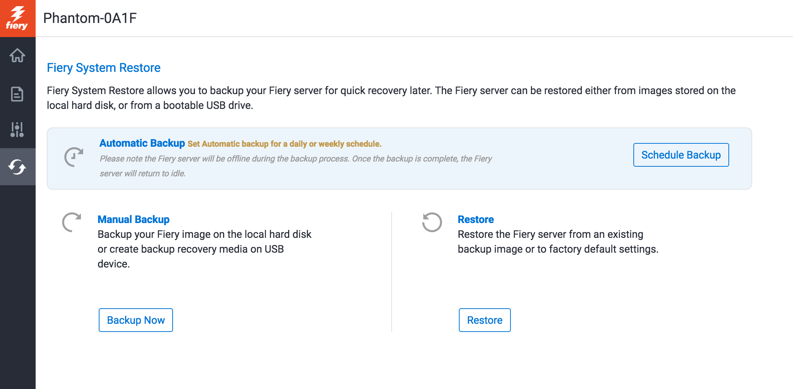
自動系統備份
在 Fiery QuickTouch 和 WebTools 設定備份排程
不到一個小時就能還原 Fiery 伺服器
  從 DVD 套件載入僅需 1/8 的時間
不需要 DVD 套件
Notes:
Fiery administrators now have an easy way to schedule automatic Fiery system backups to guarantee fast recovery — and without the need to restore from a DVD media kit.
They can manage backups using Fiery WebTools or the Fiery QuickTouch interface. With these tools, it can take less than an hour to restore from a backup — 1/8th of the time it takes to restore from a DVD kit.

Slide 28
整合增強功能
全新的 API 和易用性改善功能可輕鬆在 Fiery API v4 中整合內部應用程式
啟用 JDF 功能的全新 Fiery 具備 Fiery JDF v1.5
  EFI AutoCount
  EFI Quick Print Suite
  Kodak Prinergy 8.1
Notes:
Fiery API and Fiery JDF are always improving to bring usability enhancements and tighter integration with EFI web-to-print and MIS systems plus third-party prepress workflow solutions.

Slide 29
Fiery FS300 Pro 的重要性
在客戶著重的領域中引領創新
驅動產業最先進的數位印刷
Notes:
Fiery servers bring innovation to areas important to customers and continue the evolution of printing by driving the most advanced digital presses.

Slide 30
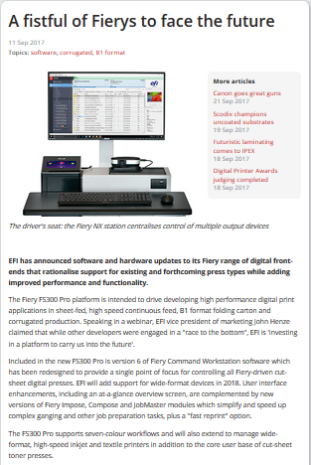
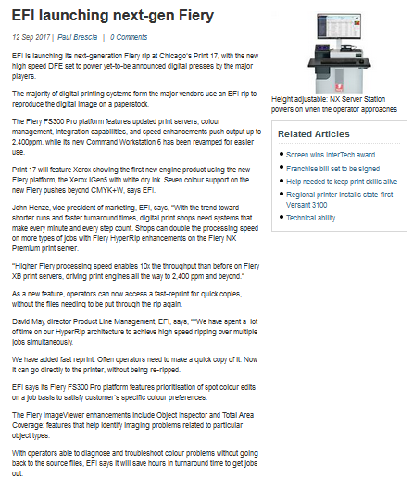
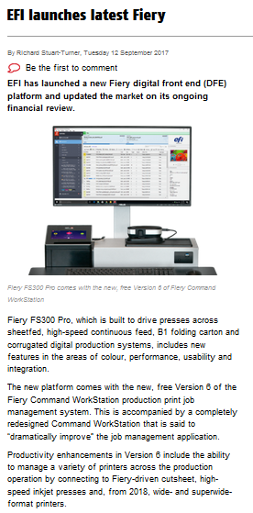
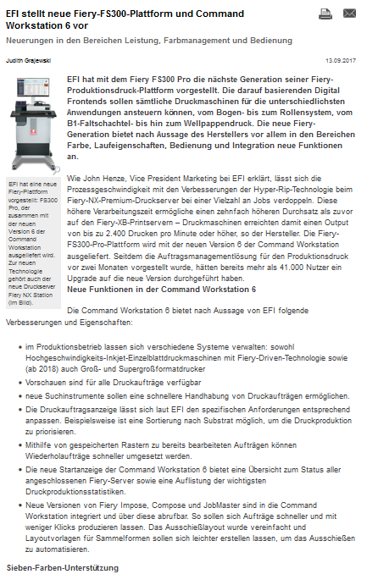
公開新聞稿
EFI 新聞稿：
  歐洲和美國：9 月 11 日
EFI 新聞稿
新聞報導
What They Think
Print Show Daily
Deutscher Drucker
PrintWeek
Australian Printer
Digital Printer
Notes:
This slide gives you links for direct access to the EFI press release posted in September 2017, and to the various press articles all around the globe.

